Slide 1
A peek into Mental Health First Aid
Marie Mulcahy
BSC Western Herbal medicine, MHFA instructor

Slide 2
What is MHFA
An international organisation that uses
Evidenced based training to improve understanding of mental health and provide effective education to provide effective intervention where needed and signposting onto relevant professionals

Slide 3
The beginning of MHFA international
HFA was developed by Betty Kitchener a nurse who had experienced her own mental health challenges and Antony Jorm a mental health literacy professor
Mental Health First Aid was developed in 2001
In 2007 the DOH introduced MHFA to England

Slide 4
Aims of MHFA
To preserve life where a person maybe at risk of harm to themselves or others
To provide help to protect the mental health issue from becoming more serious before professional help arrives
To promote the recovery of good mental health
To provide comfort to a person with a mental health issue

Slide 5
Cont Aims for MHFA
To raise awareness of mental health issues in the community
To raise awareness for mental health in the community
To reduce stigma and discrimination
To improve own health and wellbeing

Slide 6
The MHFA offerings
Standard MHFA
MHFA Lite
MHFA for those working with young people

Slide 7
Standard MHFA outcomes
At the end of the course
You will be to recognise the symptoms of mental ill health
Provide initial help
Guide people to appropriate professional help
Be mindful of your own wellbeing

Slide 8
MHFA First aid is a brand
I cannot give you tools provided by the MHFA first Aid certificate to gain the certificate you will need to attend the two day course.
I can walk you through the key facts about Mental health in the UK today

Slide 9
Facts about Mental health in uk
I person in 4 will experience some form of mental health issue in any year
At any given time 1in 6 working age adults have symptoms associated with mental ill health (e.g sleep problems, fatigue etc) which don’t meet the criteria for diagnosis

Slide 10
Mental health issues are common cont.
450 million people are affected by mental health issues worldwide
Mental illness is the largest single source of burden of disease in the UK. No other health condition matches mental illness in the combined extent of prevalence, persistence and breath of impact

Slide 11
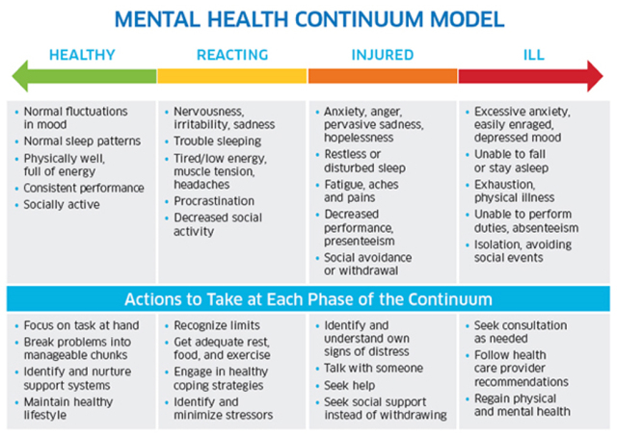
Mental health continum

Slide 12
Interactive exercise
Mental health continium

Slide 13
Anxiety definition
Is natural and useful
Think fight, flight or freeze
Is uncomfortable and so makes us take action to become sate
Both a body and mind response

Slide 14
Anxiety disorder
More severe than normal anxiety
Is longer lasting
Upsets work, relationships and social life
Costly to the individual and society in general
Often goes unrecognised and so untreated

Slide 15
Signs of anxiety
Symptoms of anxiety
People often experience physical, psychological and behavioural symptoms when they feel anxious or stressed.
Some of the most common physical symptoms of anxiety are:
Increased heart rate
Increased muscle tension
“Jelly legs”
Tingling in the hands and feet
Hyperventilation (over breathing)
Dizziness
Difficulty in breathing
Wanting to use the toilet more often
Feeling sick
Tight band across the chest area
Tension headaches
Hot flushes
Increased perspiration
Dry mouth
Shaking
Choking sensations
Palpitations

Slide 16
Psychological symptoms of anxiety
Some of the most common psychological symptoms (the thoughts or altered perceptions we have) of anxiety are:
Thinking that you may lose control and/or go “mad”
Thinking that you might die
Thinking that you may have a heart attack/be sick/faint/have a brain tumour
Feeling that people are looking at you and observing your anxiety
Feeling as though things are speeding up/slowing down
Feeling detached from your environment and the people in it
Feeling like wanting to run away/escape from the situation
Feeling on edge and alert to everything around you

Slide 17
Examples of anxiety disorders
Generalised anxiety disorder (GAD)
Panic disorder
Phobia – (social agoraphobia, specific phobia)#
Post traumatic stress disorder PTSD
Acute stress disorder ASD
Obsessive compulsive disorder OCD

Slide 18
Some anxiety disorders
Generalised anxiety disorder (GAD)
Panic disorder
Phobias (social , acrophobia, specific phobias)
Post traumatic stress disorder (PTSD)
Acute stress disorder (ASD)
Obsessive –compulsive disorder (OCD)

Slide 19
Definition of depression
Diagnosis
How do I diagnose depression?
Depression is diagnosed using the Diagnostic and Statistical Manual of Mental Disorders, fifth edition (DSM-5) criteria.
Assess for the two 'core' symptoms of depression by asking:
  During the last month have you often been bothered by feeling down, depressed, or hopeless?
  Do you have little interest or pleasure in doing things?
If either of the two 'core' symptoms have been present most days, most of the time, for at least 2 weeks, ask about:
  Other typical symptoms of depression:
    Fatigue/loss of energy.
    Worthlessness/excessive or inappropriate guilt.
    Recurrent thoughts of death, suicidal thoughts, or actual suicide attempts.
    Diminished ability to think/concentrate or indecisiveness.
    Psychomotor agitation or retardation.
    Insomnia/hypersomnia.
    Significant appetite and/or weight loss.
  Symptoms of atypical depression. These include reactive mood, increased appetite, weight gain, excessive sleepiness and sensitivity to rejection.

Slide 20
Depression
  Symptoms of atypical depression. These include reactive mood, increased appetite, weight gain, excessive sleepiness and sensitivity to rejection.
A symptom is counted as significant if it is sufficiently severe and/or persistent to be causing significant distress or functional impairment.
  Depression is diagnosed if the person has at least five out of the nine symptoms listed above, with at least one of these a 'core' symptom.
  'Subthreshold depressive symptoms' is diagnosed if the person has at least two, but less than five, symptoms that are required for the diagnosis of depression. They are usually able to cope with everyday life.
  'Persistent subthreshold depressive symptoms' (sometimes termed dysthymia) is diagnosed if the person:
    Has at least 2 years of depressed mood for more days than not, which is not the consequence of a partially resolved 'major' depression, and
    Has at least two, but less than five of the symptoms that are required for the diagnosis of depression.

Slide 21
Depression definition cont
  Seasonal affective disorder is diagnosed if the person has episodes of depression which recur annually at the same time each year with remission in between (usually appearing in winter and remitting in spring).
Investigations are not routinely indicated for people with depression, but may be necessary to exclude other causes for symptoms or conditions known to be associated with depression (see Differential diagnosis). Basic laboratory tests that may be indicated include:
  Biochemistry: blood glucose, urea and electrolytes, creatinine, liver function tests, thyroid function tests, calcium levels.
  Haematology: full blood count and erythrocyte sedimentation rate.

Slide 22
Anxiety and depression
High level of anxiety over a long time may lead to a person developing depression
People can have aspects of many anxiety disorders

Slide 23
Rate per 100,000 of deaths by suicide* in the UK, 2011-2013
What are the recent trends?
There were 6,708 suicides in the UK and ROI in 2013.
In 2013, 6,233 suicides were registered in the UK. This corresponds to a
rate of 11.9 per 100,000 (19.0 per 100,000 for men and 5.1 per 100,000
for women).
The male suicide rate is the highest since 2001. The suicide rate
among men aged 45-59, 25.1 per 100,000, is the highest for this group
since 1981.
Male suicides in Wales rose by 23 per cent between 2012 and 2013.
The rate for males (26.1 per 100,000) is at its highest since 1981.
Scotland and Northern Ireland show higher suicide rates in general
for all persons, males and females; however, rates are not necessarily
directly comparable.
Unlike the trend in the UK as a whole and in other constituent nations,
the suicide rate in Scotland has declined since 2007.
Rates in the Republic of Ireland have fluctuated more than in the UK in
recent years, but have declined in the last two years.
The recent increase in the UK is not surprising given the context of a
challenging economic environment and its social impact.

Slide 24
Suicidal or not
Don’t be afraid to discuss the subject
Establish if they have a history of attempting
Suicide
Do they thoughts of suicide
Do the have a plan
Do they have the means

Slide 25
Signs for suicide
Expressions of hopelessness or helplessness
Overwhelmed by shame or guilt
Extreme changes in personality and or appearance
Change in sleeping or eating
A serious drop in work or study performance
Lack of interest in the future

Slide 26
Sucide signs cont
Written or spoken notice of intention to end life
Putting affairs in order giving away processions
Use of suicide chat rooms
Talking about suicide those who talk about often go on to complete suicide

Slide 27

Lived experience of suicide

