Slide 1
Handout NIMH Conference October 2017
Gillian Leddy Prescott FNIMH –
What is the evidence for the action of expectorants? How can a drug specifically facilitate expectoration? The British National Formulary advocates a simple linctus to serve as a useful placebo. We will look at some observations of various herbs in action and some available research in an attempt to find a rationale for their efficacy that is not just placebo!

Slide 2
Expectoration and other actions on the respiratory tract.
As most people will get coughs and colds some time or other in the year, so new and existing patients will call for symptomatic relief of acute infection, the wish to avoid antibiotics, troublesome post viral coughs that drag on for weeks, a tendency to succumb to frequent respiratory infections or for chronic complaints such as rhinitis, asthma, bronchitis and chronic obstructive pulmonary disease (COPD).

Slide 3
Long term treatment effects
We all know how effective our respiratory remedies can be in reducing symptoms, severity and length of an acute respiratory illness and also by treating underlying weaknesses in any body system, we’re able to modify the imbalances that contribute to either being prone to infection or getting complications.
And it’s the long term treatment effects that I want to focus on.

Slide 4
COPD
Symptoms and signs include chronic cough, wheeze, dyspnoea, fatigue, frequent respiratory infections, congestive heart failure, respiratory failure.
COPD pathophysiology - Hypertrophy of mucous glands and increase of mucus secreting goblet cells. Chronic inflammation leading to hyperplasia and narrowing of airways with fibrotic changes in bronchial walls, reduction in number of small airways and airway collapse, CD8 + lymphocytes, neutrophils, CD68+ monocytes/macrophages.

Slide 5
Pulmonary Surfactant
The importance of pulmonary surfactant –Pulmonary surfactant reduces surface tension and the pressure difference needed for compliance for the lung to be able to expand and inflate. It regulates alveolar size and rate of expansion and shrinking to prevent atelectasis at the end of expiration. It also acts to reduce fluid accumulation to keep airways dry. It has an immune function innate immunity with proteins SP-A and SP-D and regulates inflammatory responses
Pulmonary surfactant is a surface active lipoprotein complex formed by type II alveolar cells. The main lipid component dipalmitoylphosphadtidylcholine (DPPC) reduces surface tension.
So compliance and ventilation decreases as changes occur in lung tissue in COPD Veldhuzen, E.J.A et al

Slide 6
Dyslipidaemia
Dyslipidemia, a condition involving elevated serum triglyceride (TG), elevated serum low density lipoprotein cholesterol (LDL-C), and/or low serum high density lipoprotein cholesterol (HDL-C)
A connection between cholesterol dysregulation and pulmonary immunity.
There have been recent clinical trials with simvastatin and although it was found not to prevent exacerbations in COPD patients at increased risk and no indication for statin, observational studies suggest statins may have positive effects on some patients with CPOD who are treated for CV and metabolic conditions.
Emerging Roles for Cholesterol and Lipoproteins in Lung Disease
Gowdy, K.M., , Fessler,M.B. Published online (2012 Jun 15) doi 10.1016/j.pupt.2012.06.002

Slide 7
Dyslipidaemia
New research suggests that dyslipidaemia may be a contributing factor in COPD development.
HDL is the major source of vitamin E for alveolar type II cells and promotes surfactant production and growth of fibroblasts.
Anti-oxidants are important to prevent cytotoxic and pro-inflammatory formation of lipids on an alveolar surface exposed to acute lung injury and environmental oxidants.
Cholesterol regulates immune responses in the lung and dyslipidaemia can alter pulmonary innate and adaptive immune responses, increasing susceptibility to pathogens in the lung.

Slide 8
The case for expectorants.
In the definition by Lauder Brunton 1885 the British physiologist and lecturer in materia medica at St Barts. (Thanks to Mills and Bone for finding the definition)
Expectorants are remedies which facilitate the removal of secretions from the air passages, The secretions may be reduced, more ease of removal by an alteration in its character or by increased activity of the expulsive mechanism.
1 Brunton,L.,(1885) Mills, S..,Bone, K.,(2000) Principles & Practice of Phytotherapy. 208

Slide 9
Herbal Expectorants
So the action of an expectorant can be
Mucolytic – making mucus less viscid or sticky. E.g.Allium sativum, Inula helnium
Stimulating the mucocilliary escalator by reflex activity from stimulation of the upper digestive tract e.g. Ipecaquanha, Lobelia
Antispasmodic - reducing spasm in smooth muscle in the airways e.g. Datura, Thymus.
Anti-inflammatory/anticatarrhal – thereby decreasing overproduction by goblet cells and airflow obstruction. E.g. Plantago lanceolata.
Warming – Increase blood flow to respiratory mucosa E.g. Capsicum minimum.

Slide 10
Differential Diagnosis
First you have to diagnose, and then build up a system to help you monitor your patient’s progress.
Blood tests for inflammatory markers, X-rays, spirometry(post bronchial dilator FEV1/FCV <0.70)(FVC = FEV6) and symptom picture can give a diagnosis or differential diagnosis but to determine how to help manage and monitor the patient

Slide 11
GOLD staging system
The Global Initiative for Chronic Obstructive Lung Disease (GOLD) have produced guidelines for staging the severity of COPD and other lung diseases.
The most recent guidelines include
FEV1 (Forced expiratory volume for 1 second) readings
symptoms e.g. dyspnoea
exacerbations e.g. infections needing treatment or hospitalisation
exercise capacity e.g. 6 minute walk test
Pocket guide to COPD diagnosis Management & prevention. A guide for Health Care Professionals (2017 )

Slide 12
Gold Stages
Based on the FEV1 score, you receive a GOLD grade or stage as follows:
GOLD 1: FEV1 of 80 percent or more - Mild
GOLD 2: FEV1 of 50 to 79 percent- Moderate
GOLD 3: FEV1 of 30 to 49 percent- Severe
GOLD 4: FEV1 of less than 30 percent- Very Severe
Based on the other criteria, people with COPD will be in one of four groups: A, B, C, or D.
Pocket guide to COPD diagnosis Management & prevention. A guide for Health Care Professionals (2017 )

Slide 13
Comprehensive Assessment Test (CAT)
On scale of 0 to 5 (5 being worst)
Energy versus Fatigue,
Sleep V Disturbed sleep due to lungs,
Confidence in getting out V Staying in,
Active at home V Limited activity,
Walking up incline V SOB on incline or stairs,
No chest tightness V Chest tight,
No mucus V Mucus,
No cough V Cough
Pocket guide to COPD diagnosis Management & prevention. A guide for Health Care Professionals (2017 )

Slide 14
SOB graded by Modified Medical Research Council (Fletcher CM BMJ 1960 2:1662) – (m-MRC )
Grade 0 – I only get SOB on strenuous exercise
Grade 1 – I get SOB when hurrying on the level or going up slight hill.
Grade 2 – I walk slower than others on the level due to SOB. I have to stop for breath when walking at own pace on level.
Grade 3 – I stop for breath after walking 100m or after a few minutes on level.
Grade 4 – I’m too SOB to leave the house or when dressing.

Slide 15
GOLD Groups ABCD
Group A or B - No exacerbations or one that did not require hospital admission in the past year depending on an assessment of their breathing. mMRC 0-1 and CAT<10 group A, mMRC 2+ and CAT >10 group B
Group C or D - Two or more exacerbations that didn’t require hospital admission in the past year, or one exacerbation that did would be in Group C or D. mMRC 0-1 and CAT<10 group C, mMRC 2+ and CAT >10 group D
Patients in GOLD Grade 4, Group D, would have the most serious classification of COPD. And they may have a worse outlook and shorter life expectancy than someone with a label of GOLD Grade 1, Group A. Pocket guide to COPD diagnosis Management & prevention. A guide for Health Care Professionals (2017 )

Slide 16
Goals or treatment of stable COPD
include
reducing symptoms by relieving symptoms,
improving exercise tolerance
improving health status.
Pocket guide to COPD diagnosis Management & prevention. A guide for Health Care Professionals (2017 )

Slide 17
Key points of treatment
include
avoiding irritants such as smoke and other air pollutants,
pharmacological therapy to reduce frequency and severity of exacerbations
improve health status and exercise tolerance
Pocket guide to COPD diagnosis Management & prevention. A guide for Health Care Professionals (2017 )

Slide 18
Patient case study
Male patient age 75 born in 1919, grew up in London, worked in Smithfield market. Smoked from age 15. DX COPD ‘91 -chronic bronchitis, emphysema and mild heart failure.
Main symptoms, gradually deteriorating over last 3 years - Difficulty breathing, morning cough and frequent coughing fits, yellowish sometimes green phlegm, clear towards end of day, woken by cough in night, wheezing on and off, tight chest on walking “a long way” SOB on incline, slows down on incline and stairs

Slide 19
Infection timeline
Before first visit.
Feb 1992 antibiotics and Rx Bendrofluazide 2.5mg
April 1993 before prostate surgery had Chest x ray – scarring in left lung base due to bronchitis more antibiotics and increased Bendrofluazide to 5mg.
Sept 1993 Chest infection, 2 courses Antibiotics and after that noticed tight chest when walking “a long way”
Dec 1993 Chest infection, needing antibiotics.
14th Feb 1994 chest infection needing 2 courses antibiotics Suprax – Cefedrin and 2 days before FV given another 5 day course.

Slide 20
Started herbal treatment
2nd March 1994 Herbal treatment, phyllocontin tablets and bendrofluozide. FEV1 330 64% gold 2 group D
9th March 94 Felt cold and flu coming on. Gave mix and tea FEV1 350
16 March 94 All symptoms better. No coughing fits FEV1 390 76% gold 2 group B
GP given list of herbs prescribed and was pleased with patient’s recovery
Well for 10 months

Slide 21
First Prescription
RX Thymus vulgaris 30ml
Populus candicans 15ml
Marrubuim vulgare 40ml
Echinacea angustifolia 20ml
Datura stramonium 3ml - 108ml x2
Sig 5ml qid
RX Allium succus 200ml sig 5ml qid

Slide 22
Fairly Stable
18 Jan 95 Cold symptoms. Took emergency mix and did not develop. FEV1 310 61% Gold 2 Group B
6 Sept 95. No infections. White frothy sputum FEV1 270 53% Well for 13 months
Feb 96 One course of antibiotics for sudden virus and chest infection, also took emergency mix.
27 Mar 96 Well. Diuretic 40 mg reduced to 20mg. FEV1 300 59% Gold 2 Group A
Well for 11 months

Slide 23
1997 Not a good start to year
21 Jan 97 Slight cold and sputum green so took antibiotics along with emergency mix.
8 Apr 97 Took course of antibiotics for Campilobacter pylori. After, felt breathless with cough and green sputum. Took emergency mix but ran out a week ago. Rx more emergency mix and course of antibiotics FEV1 230 49% Gold 3 group B
25 Jun 97. Well. FEV1 290 58%
12 Nov 97 Well. FEV1 300 60% Gold 2 Group B
Well for 19 months

Slide 24
Continuing treatment
3 Nov 98 Heavy cold green phlegm. Had run out of med and emergency mix. FEV1 250. Took more mix and got better. FEV1 260 53%
Well for 17 months
26 Apr 00- Well since Nov 98 .Breathing not so good in last 3 weeks though no infections. Having to get up to sleep in chair. Copious clear catarrh. GP gave antibiotics 4-5 weeks ago just in case but felt bad on them so stopped. FEV1 240
6 Sept 00 Quite well since April but started with cold and cough in last week. Had stopped frusemide 6 months before due to urgency. Will take again.
Well for 18 months

Slide 25
A break in treatment
6 Mar 02 Quite well from Sept 00 till Feb 02. Had chest infection. Course of antibiotics finished 2 weeks ago and felt ill with these. Took more emergency mix and sputum clear. Rx Oxygen FEV1 230
11 Dec 02 Well for 9 months. Since flu jab in Nov has not felt right. Slightly dizzy when gets up, occ. greenish sputum. Took emergency mix and antibiotic as was going away for Christmas. FEV1 210 Well for 5 months
15 May 03 Had been given antibiotics. Uses Oxygen for 30 seconds before going upstairs. Salbutamol 2 puffs 4-5 x per day. Smoking 5 per day. FEV1 230- 49% Gold 2 Group B
Quite well over 03-04. Breathing stable FEV1 around 230, no infections. Still has emergency mix and plenty medicine.

Slide 26
Return to treatment
13 April 06 Well for 18months then had 3-4 lots of antibiotics in last year or so. Oxygen after any exertion. Very limited mobility. Stage 2 pressure sore. Taking Frusemide 40mg. FEV1 170 – 35% Gold 3 Group D
23 May 06 On herbs again since April. More active, pressure sore improving. Stopped smoking! FEV1 220
28 Nov 06 Keeping well, no infections. SOBOE but walking more. Using salbutamol frequently in mornings FEV1 230
16 May 07 to May 08 Well, no infections gets up to walk around every half hour, round house and garden. Pressure sore nearly healed and under control. Not troubled by cough, just a little whitish phlegm.
July 08 Died peacefully in sleep.

Slide 27
Graph showing FEV1 decline

Slide 28
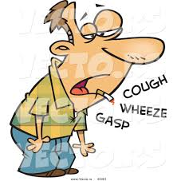
What difference would it have made to give up smoking?

Slide 29
Mortality Rates
The average five-year mortality rate of someone with COPD ranges between 40 and 70% depending on the severity.
According to a 2009 study in the International Journal of Chronic Obstructive Pulmonary Disease, a 65-year-old man with COPD has the following reductions in life expectancy:
Smoker
stage 1: 0.3 years
stage 2: 2.2 years
stage 3 or 4: 5.8 years
Former smoker
stage 2: 1.4 years
stage 3 or 4: 5.6 years
Never smoked
stage 2: 0.7 years
stage 3 or 4: 1.3 years
For former smokers and never smokers, the difference in life expectancy for people at stage 0 and people at stage 1 was statistically insignificant.
International Journal of Chronic Obstructive Pulmonary Disease, (2009)

Slide 30
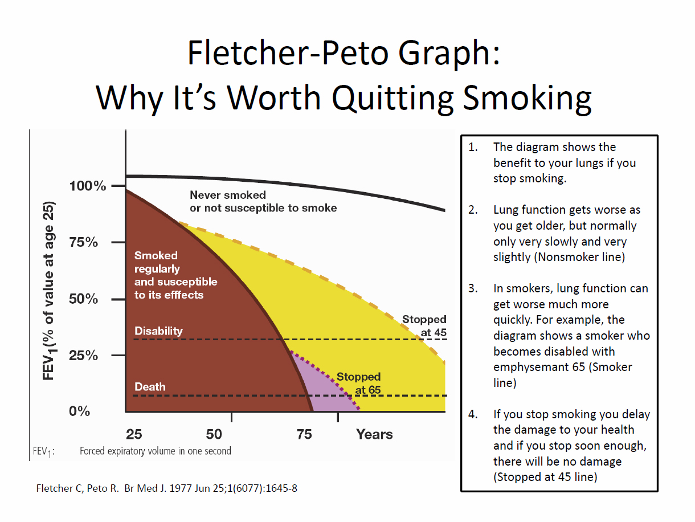

Slide 31
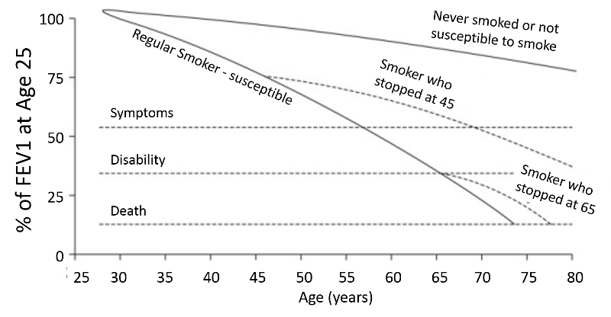
Fletcher –Peto Graph

Slide 32
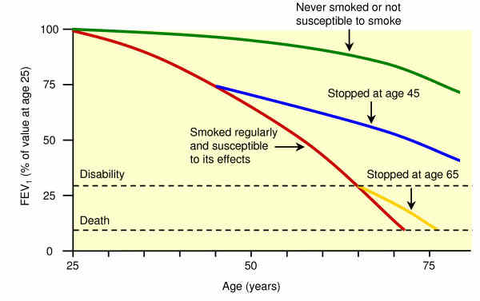
Another version of the same

Slide 33
RX Emergency Mix example
Thymus vulgaris 30ml
Asclepias tuberosa 20ml
Echinacea angustifolia 50ml
Marrubium vulgare 20ml
Plantago lanceolata 10ml
Allium sativa 1:1 50ml Sig 5ml qid

Slide 34
RX Main mix example
Marrubium vulgare 20ml
Thymus vulgaris 20ml
Inula helenium 20ml
Echinacea angustifolia 20ml
Ginkgo biloba 2:1 10ml
Datura stramonium 5 ml
Crataegus lavegata FE 10ml
Convallaria majalis 5ml Sig 5ml tds

Slide 35
Other herbs used
Sambucus nigra flos and fruct, Glycyrrhiza glabra, Rheum palmatum, Althaea officinalis, Verbascum Thapsus, Populus candicans, Lobelia inflata, Pimpinella officinalis and ALWAYS lots of Garlic as juice or in fluid extract.

Slide 36
Marrubium vulgare L. aerial parts
Constituents: 0.3-1% of the bitter principle diterpene marrubiin(formed from premarrubiin) Antiinflammatory, analgesic, antioxidant, cardioprotective, vasorelaxant, gastroprotective, antispasmodic, immunomodulating,
Phenylpropenoids, - anti-oxidant , immunomodulating, anti-inflammatory.
Sesquiterpenes – expectorant, mucolytic, antibacterial.
Alkaloids – Stachydrine - cardioprotective
Bitter lactone, flavonoids, saponin, sterols, tannins - polyphenols, vitamin C, and 0.06% of volatile oils - anti-microbial and antioxidant

Slide 37
Marrubium vulgare Actions
Actions which have been supported by various studies demonstrating cytotoxicity, immunomodulating, vasorelaxant, expectorant, antispasmodic, hypolipidemic, hypoglycemic, and analgesic properties.
Phenylpropanoid glycosides (PPGs) present in several medicinal plants (including Marrubium, Verbascum and Plantago) actions include antioxidant and free acid radical scavenger mechanisms.
Acteoside and caffeic acid have been shown to inhibit recruitment of leukocytes, particularly neutrophils and eosinophils into lung
Anti-inflammatory activity - Glycosidic phenylpropanoid esters showed an inhibitory activity towards the Cox-2 enzyme and three of them: acteoside 2, forsythoside B 3, arenarioside 4, exhibited higher inhibitory potencies on Cox-2 than on Cox-1.
Sahpaz, S., et al. Isolation and pharmacological activity of phenylpropanoid esters from Marrubium vulgare, Journal of Ethnopharmacology Volume 79, Issue 3,(March 2002), 389-392.

Slide 38
Constituents and actions
Phenylpropanoid glycosides such as acteoside 1, forsythoside B 2, arenarioside 3, and ballotetroside 4 have been implicated as the active constituents involved in inhibition of low-density lipoprotein (LDL) oxidation.
Marrubium vulgare extract inhibits human-LDL oxidation and enhances HDL-mediated cholesterol efflux in THP-1 macrophage.
The composition of the essential oil obtained from the dried flowering aerial parts of Marrubium vulgare L. (Labiatae) was analyzed by GC and GC/MS. Twenty components have been identified in the essential oil of M. vulgare. The major constituents of the essential oil were β-bisabolene (20.4%), δ-cadinene (19.1%) and isocaryophyllene (14.1%)
Katayoun Morteza-Semnani , Majid Saeedi & Esmaeil Babanezhad
Journal of Essential Oil ResearchPublished Online: 08 Dec 2011)

Slide 39
Verbascoside
Verbascoside - a polyphenol is a caffeoyl phenylethanoid glycoside (CPG). It is an ester formed with the phenylethanoid hydroxytyrosol, the phenylpropanoid caffeic acid and the sugar alpha-L-rhamnopyranosyl-(1->3)-beta-D-glucopyranose
Verbascoside has an antimicrobial activity, notably against Staphylococcus aureus. It has anti-inflammatory, antioxidant and photoprotective properties.
Found in many plants including Plantago lanceolata, Verbascum, Verbena officinalis.
Pan J, Yuan CS, Lin CJ, Jia ZJ, Zheng RL (2003) Pharmacological activities and mechanisms of natural phenylpropanoid glycosides. Pharmazie 58:767–775. doi:10.1002/chin.200405273PubMedGoogle Scholar

Slide 40
Inula and Allium
Inula helenium – Inulin, mucilage – helps to absorb calcium and magnesium, soluble fibre as prebiotic, volatile oils including helenin, camphor, alantol, sesquiterpene lactones – alantolactone – expectorant, mucolytic, antibacterial and antifungal. Triterpenoid saponins, sterols and bitter.
Allium sativum – Sulphur compounds including allicin and ajoene – anti microbial, antioxidant. Flavonoids, polyphenols, saponins.
Actions include lowering blood pressure, reducing serum cholesterol, triglyceride and LDL, and mucolytic – sulphydryl group works in similar way to N-acetylcysteine to break down mucus glycoproteins.

Slide 41
Outcomes
There’s always the question of whether he would have lived longer had he taken antibiotics instead of emergency mix and steroids instead of herbal anti-inflammatories. Would the patient be better off receiving in-patient hospital care and treatment?
What I learnt from this case was that herbal treatment could make a positive difference to the quality of his life by reducing the need for antibiotics and hospitalisations, and by making, for many years significantly large, and latterly smaller improvements to his breathing, mobility, improved energy, and most importantly, his sense of wellbeing and enjoyment of life.

Slide 42
Summary
Many different pulmonary herbs can be used with same effect
Herbal expectorants contain complex, multi-actioned components which have a range of effects
They can play a part in regulating pulmonary lipid homeostasis by anti-inflammatory, antioxidant and immune modulating action
Reducing pathogens and damage caused by environmental oxidants, improving compliance of distal airways, improving lung capacity and ventilation
Supporting cardiovascular health
Patients always have a choice

Slide 43
Labdane diterpenoids
Abstract Phytochemical investigation of the whole plant of Marrubium vulgare L. (Lamiaceae) resulted in isolation and characterization of two new labdane diterpenoids, 12(S)-hydroxymarrubiin and 3-deoxo-15-methoxyvelutine C and 11 known compounds, marrubiin, peregrinin, thessaline D, marrubinone B, deacetylvitexilactone, verbascoside, leucosceptoside A, martynoside, anisofolin A, terniflorin, and apigenin. Structure elucidation of the isolated compounds was determined by using spectroscopic techniques and HRESIMS. 12(S)-Hydroxymarrubiin, marrubiin, peregrinin, and marrubinone B, exhibited no antimicrobial activity up to 20 μg/mL against ten strains.
Labdane diterpenoids from Marrubium vulgare (PDF Download Available). Available from: https://www.researchgate.net/publication/282378990_Labdane_diterpenoids_from_Marrubium_vulgare [accessed Sep 18, 2017].

Slide 44
References
Isolation and pharmacological activity of phenylpropanoid esters from Marrubium vulgare https://doi.org/10.1016/S0378-8741(01)00415-9Get rights and content
Author links open overlay panelSevserSahpazªNancyGarbacki^{b}MoniqueTits^{b}FrançoisBailleulª
Phenylpropanoid glycoside analogues: enzymatic synthesis, antioxidant activity and theoretical study of their free radical scavenger mechanism.
López-Munguía A¹, Hernández-Romero Y, Pedraza-Chaverri J, Miranda-Molina A, Regla I, Martínez A, Castillo E

Slide 45
references
Six-Minute Walk Distance in Patients With Severe End-Stage COPD
ASSOCIATION WITH SURVIVAL AFTER INPATIENT PULMONARY REHABILITATION
Dr. Kyle Enfield, MD, MS, Ms. Sally Gammon, MS, RN, Ms. Jennifer Floyd, MSPT, Ms. Cassandra Falt, RRT, Mr. James Patrie, MS, Dr. Thomas A. Platts-Mills, MD, PhD, Dr. Jonathon D. Truwit, MD, and Dr. Y. Michael Shim, MD
J Cardiopulm Rehabil Prev. Author manuscript; available in PMC 2011 Mar 2.
Published in final edited form as:
J Cardiopulm Rehabil Prev. 2010 May–Jun; 30(3): 195–202.
doi: 10.1097/HCR.0b013e3181c565e4
Prim Care Respir J. 2011 Dec;20(4):434-40. doi: 10.4104/pcrj.2011.00082.
Measuring walking speed in COPD: test-retest reliability of the 30-metre walk test and comparison with the 6-minute walk test.
Andersson M¹, Moberg L, Svantesson U, Sundbom A, Johansson H, Emtner M.

Slide 46
References
Pulm Pharmacol Ther. Author manuscript; available in PMC 2014 Aug 1.
Published in final edited form as:
Pulm Pharmacol Ther. 2013 Aug; 26(4): 430–437.
Published online 2012 Jun 15. doi: 10.1016/j.pupt.2012.06.002
PMCID: PMC3466369
NIHMSID: NIHMS387313
Emerging Roles for Cholesterol and Lipoproteins in Lung Disease
Kymberly M. Gowdy and Michael B. Fessler
Author information ► Copyright and License information ►
The publisher's final edited version of this article is available at Pulm Pharmacol Ther
See other articles in PMC that cite the published article.

Slide 47
The Essential Oil Composition of Marrubium vulgare L. from Iran and Egypt
Katayoun Morteza-Semnani, Majid Saeedi & Esmaeil Babanezhad
Pages 488-490 | Received 01 Sep 2006, Accepted 01 Feb 2007, Published online: 08 Dec 2011
Download citation
http://dx.doi.org/10.1080/10412905.2008.9700065
Journal of Essential Oil ResearchPublished Online: 08 Dec 2011)
International Journal of Plant Science and Ecology
Vol. 1, No. 4, 2015, pp. 138-141 http://www.aiscience.org/journal/ ijpse
E-mail address: hussein_saidalahl@yahoo.com (H. A. H. Said-Al Ahl)
Essential Oil Composition of Marrubium vulgare L. Cultivated in Egypt
Hussein A. H. Said-Al Ahl, Ahmed S. H. Gend, Abeer A. Mahmou, Hanaa F. Y. Mohamed
Essential Oil Composition of Marrubium vulgare L. Cultivated in Egypt (PDF Download Available). Available from: https://www.researchgate.net/publication/293263065_Essential_Oil_Composition_of_Marrubium_vulgare_L_Cultivated_in_Egypt [accessed Sep 29, 2017].

Slide 48
References
Phytochemistry Letters
Volume 13, September 2015, Pages 275-279
Labdane diterpenoids from Marrubium vulgare
Author links open overlay panelMubashirMasoodi^{ab}ZulfiqarAliªShuangLiangªHongquanYinªWeiWang^{c}Ikhlas A.Khan^{ad}
https://doi.org/10.1016/j.phytol.2015.07.005

Slide 49
References
Brunton,L.,(1885) Mills, S..,Bone, K.,(2000) Principles & Practice of Phytotherapy. 208
Fletcher, C., Peto, R., BrMed J. (1977Jun 25); 1 (6007); 1645-8, Fletcher Peto Graph.
Global Initiative for Chronic Obstructive Lung Disease ,GOLD., Pocket guide to COPD diagnosis Management & prevention. A guide for Health Care Professionals (2017 ) www.goldcopd.org
Veldhuzen, E.J.A.,Haagsman, H.P. Biochimica et Biophysica Acta (BBA) – Biomembranes. Role of pulmonary surfactant components in surface film formation and dynamics , Volume 1467, Issue 2, (25 August 2000), 255–270

