Slide 1

NIMH PTB Seminar
“Exploring the use of the Schedule 3 Herbs in Herbal Practice”.
with Keith Robertson M.Sc F.NIMH
“All things are poisons, for there is nothing without poisonous qualities. It is only the dose which makes a thing poison.”
Paracelcus

Slide 2
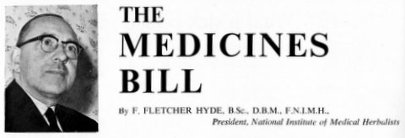

Slide 3
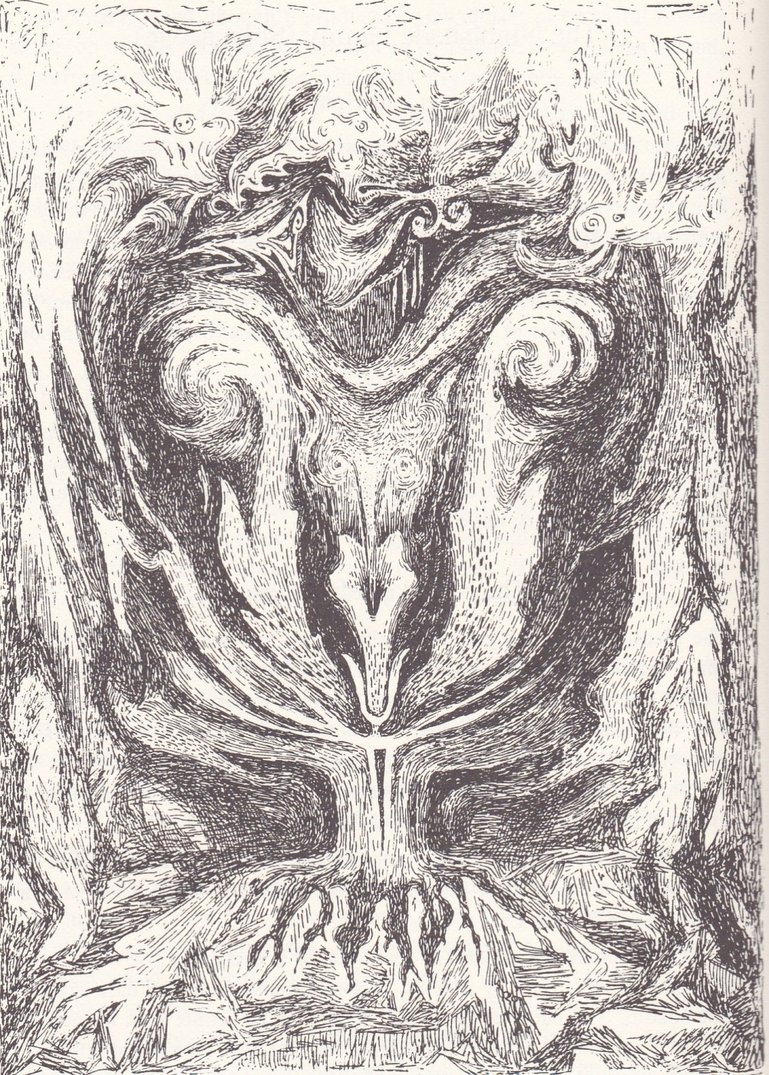
Nightshade Family
“Healing Plants” Wilhelm Pelikan Mercury Press Woodcuts Walther Roggenkamp

Slide 4
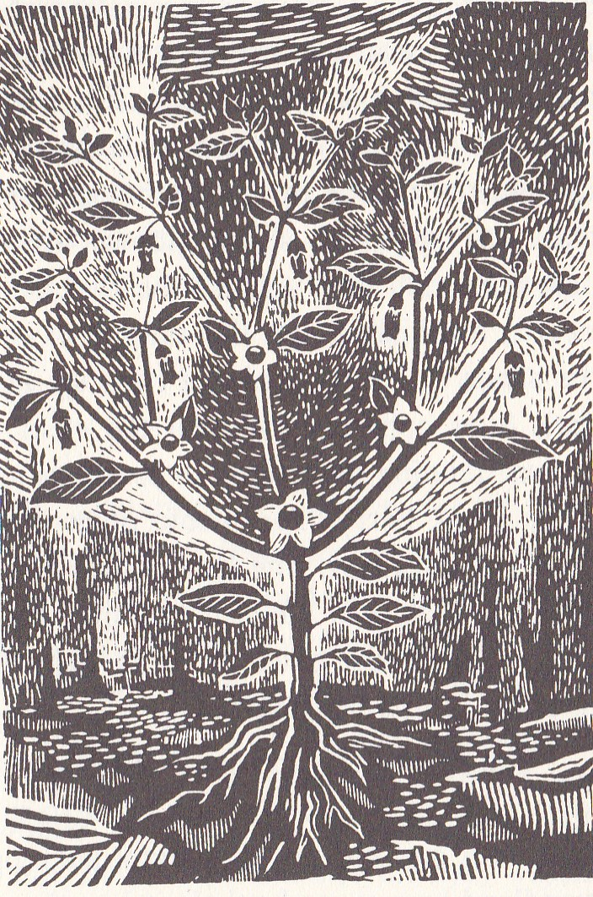
Atropa belladonna
Notes:
Belladonna

Slide 5
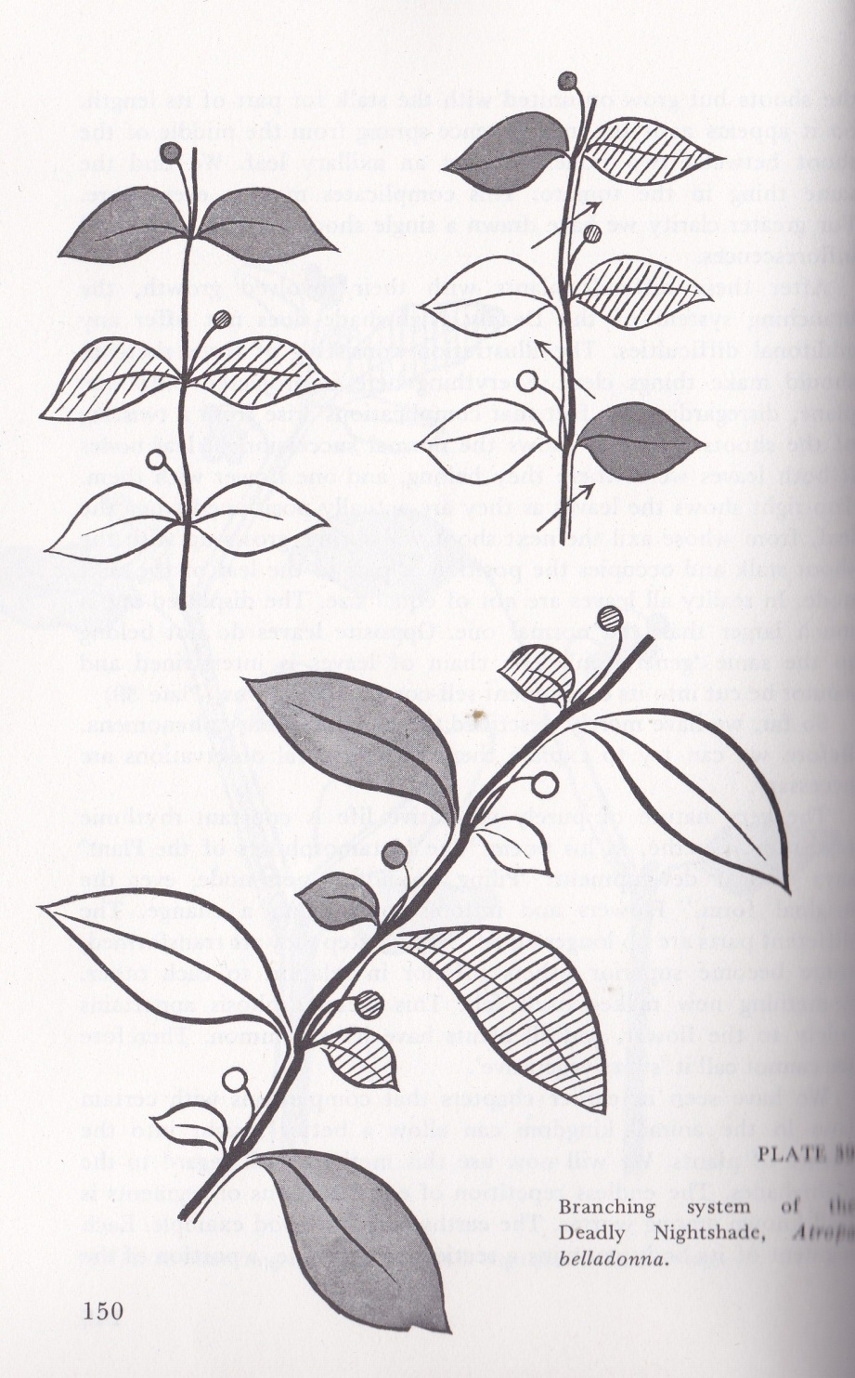

Slide 6
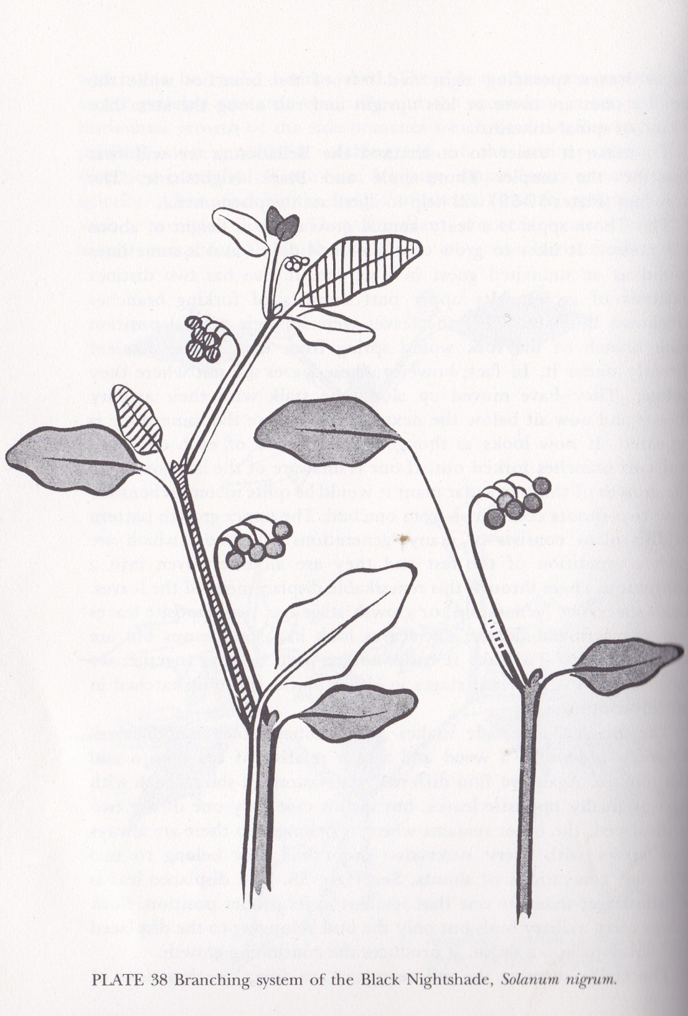

Slide 7
Belladonna in Homeopathy
Violence and Suddenness
Turmoil in Brain
“The face was red, the head hot, the look wild and staring: pupils dilated: the arteries of the neck and head visibly pulsating”.
Burning skin, throbbing pains, intolerance of pressure and jolt.
Fear of imaginary black dog
Delirium – “bites, spits , tears”.

Slide 8
Poisoning
Mouth and throat dry, can’t swallow, spasm of throat - can’t breathe, violent thirst but water aggravates, vertigo, confusion, hallucinations and stupor, pupils dilated.
Coffee is the antidote

Slide 9
Grateful acknowledgements to
Chanchal Cabrera FNIMH for info on alkaloids.
Principal alkaloids of Atropa belladonna
L-hyoscyamine (forms upon drying)
Atropine (L/D hyoscyamine)
Hyoscine (scopolamine)

Slide 10
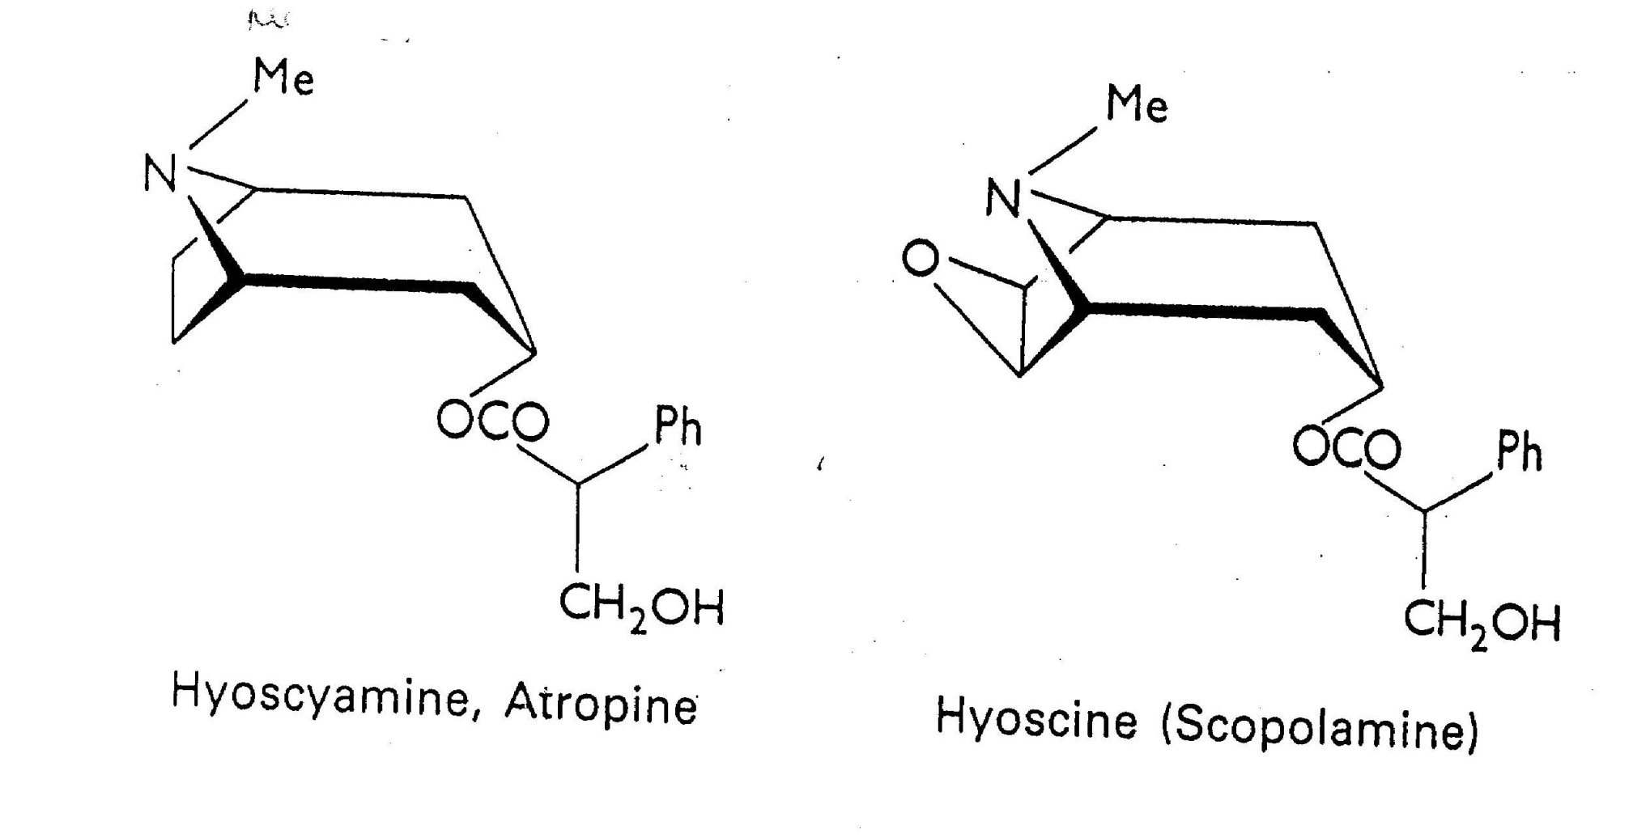

Slide 11
LD hyoscyamine (atropine) has numerous pharmacological uses:
Prevents and treats AV block and sinus bradycardia
As a urinary, respiratory or gastro-intestinal antispasmodic
As a midriatic to dilate pupils
Scopalamine is used for extreme motion sickness, vertigo and Parkinson’s disease.

Slide 12
Spasmolytic effect upon smooth muscles
Large doses affect central nervous system (brain and spinal cord)
Initial period of stimulation - Feelings of happiness, laughter, lively active imagination, urge to speak and move
Followed by confusion and hallucinations

Slide 13
Loss of mental control, fits of rage, epileptic-type seizures
Respiratory rate and depth increase, temperature rises
Skin flushes, person becomes breathless
Central narcotic paralysis, reduction in all symptoms
Coma and death

Slide 14
Atropa belladonna
Gastro-intestinal disturbances – relaxes circular and longitudinal muscles, reduce peristalsis and digestive spasms
Significantly reduces all glandular secretions –
reduces stomach acid

Slide 15
Atropa belladonna
Treatment of biliary diskinesia, projectile vomiting, chronic colitis, excessive salivation or perspiration, chronic mucous conditions, chronic inflammatory bowel disease
T

Slide 16
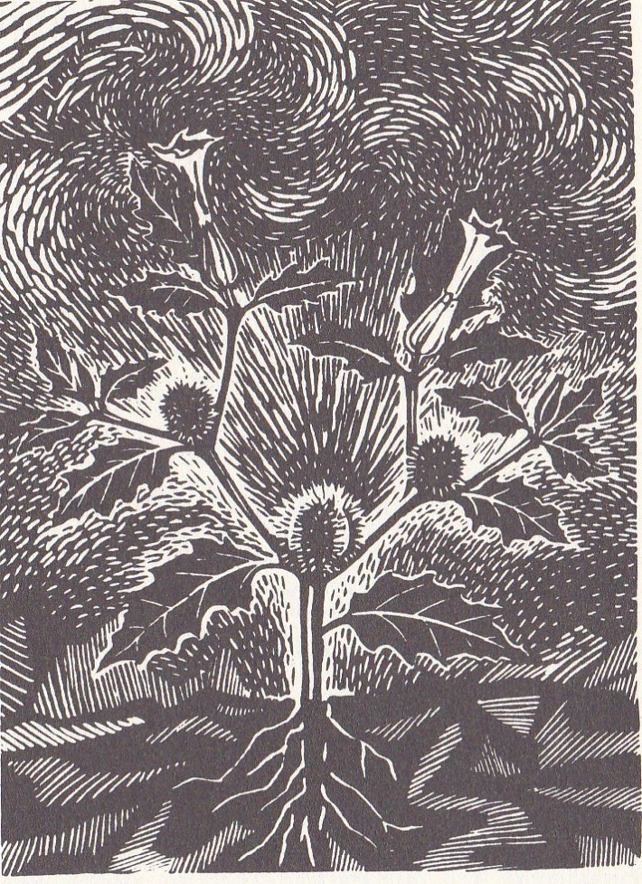
Datura stramonium

Slide 17
Datura in Homeopathy
“Locoweed”
Nymphomania, hydrophobia, mania, violent delirium, delirium tremens, epilepsy, chorea, hallucinations and fear of objects seen in imagination.
Asthma cigarettes – palliative?

Slide 18
Datura stramonium
Antispasmodic - especially in the respiratory system
Effective in relaxing bronchioles in asthmatics
Reduces excessive mucous secretions in the lungs

Slide 19
Datura stramonium for senile tremor: 15 drops per day increasing to 40 or even 60. Above Schedule 3?
Patients with organic changes in the brain have much greater tolerance for these herbs than healthy people.
(Weiss 1988)
                T

Slide 20
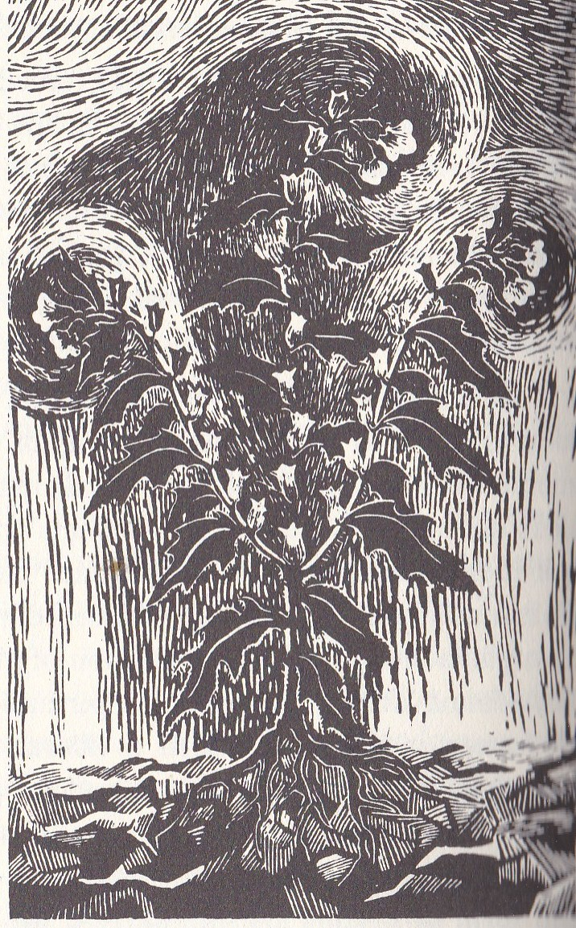
Hyoscymus niger

Slide 21
Hyoscyamus and Homeopathy
Acute mania, DT’s, insomnia, a desire to uncover rather than being too hot, horrible, lascivious mania, every muscle twitches, spasms, epilepsy.
During an epidemic of war typhus during the Napoleonic wars in 1813 in Leipsic, Hahnemann treated 183 cases with Hyoscyamus with no deaths.

Slide 22
Hyoscyamus niger
Antispasmodic activity, especially urinary system
Treatment of renal calculi, urine retention, bladder stones and severe urinary tract infections with significant pain due to spasm of the tract

Slide 23
Prophylactic for motion sickness
Treatment of Meniere’s disease

Slide 24
Dosing strategies for Atropa, Datura and Hyoscyamus
Overdosing of atropine, hyoscyamine
or hyoscine = dry mouth
Eyes sore and dry
Use with mucilaginous herbs
Therapeutic dose is close to toxic dose

Slide 25
Tincture taken 10 drops twice a day / week
Increased by 1 drop every three days until
dry mouth and visual disturbances appear
Reduced by 1 drop each day until side
effects disappear
1:10 in 45% - 65% ethanol - maximum weekly
dose 10 mL
(Hyoscyamus tincture for paralysis agitans and senile tremor, relatively large doses are needed: up to 30 drops 3-4x daily. Weiss 1988)

Slide 26
Contra-indications for Atropa, Datura and Hyoscyamus
Tachycardia, arrhythmia, glaucoma, hypertension
Mechanical stenosis of gastro-intestinal tract, pulmonary oedema and prostatic adenoma with urinary retention
May potentiate anti-cholinergic activity of tri-cyclic antidepressants, mono-amine oxidase inhibitors, quinidine (anti-arrhythmic) and amantadine

Slide 27
 | Face | Light | Fever | Apperance
Belladonna | Red | Can’t bear | Hot | spasm of the larynx
Datura | Red | Hates dark | violent, active | Risus sardonicus, stupid, friendly look
Hyoscymus | Pale sunken | N/A | not high but insanity | Purple face, eyes projecting, shrieks

Slide 28
 | Violence | Cerebral activity | Inflammatory | Fear of water
Belladonna | 2 | Up | Yes | Yes
Datura | 1 | Up | No | Yes
Hyoscymus | 3 | N/A | N/A | Yes
T

Slide 29
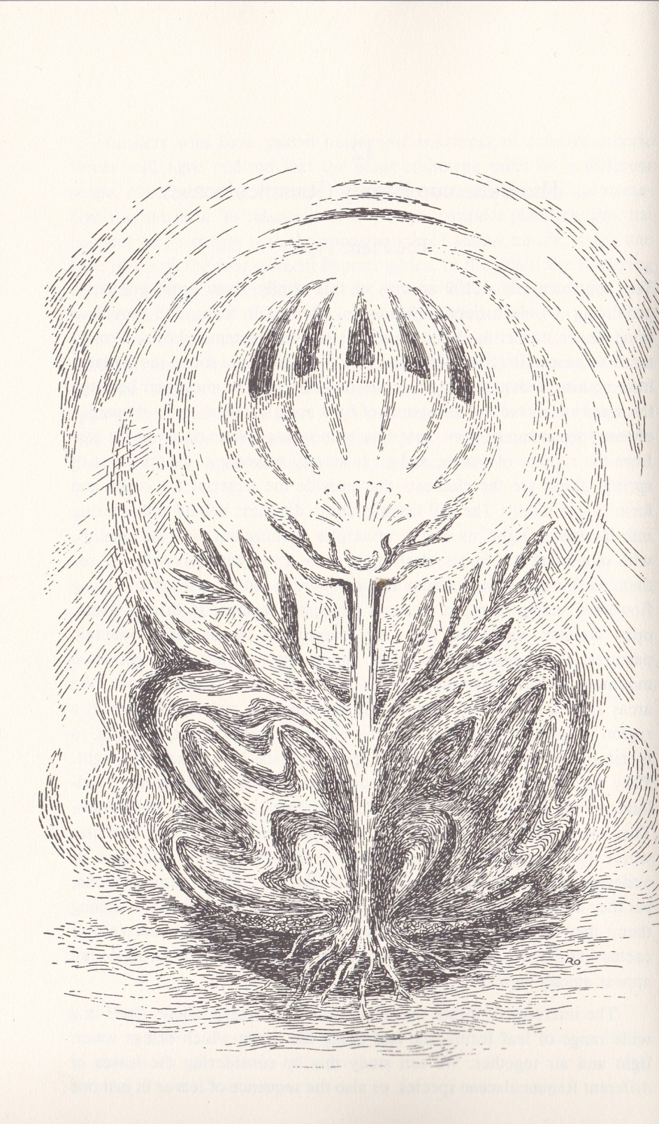
Buttercup family

Slide 30
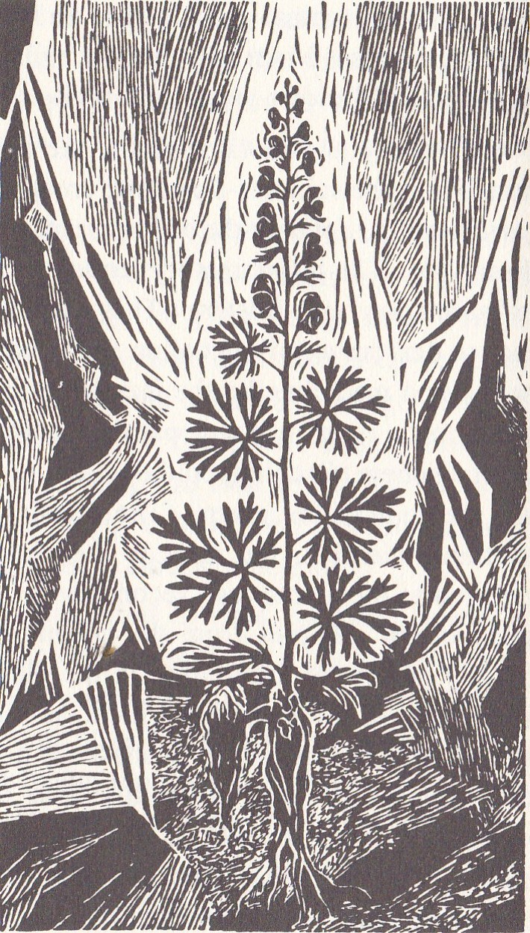
Aconitum napelus

Slide 31
Aconite in Homeopathy
Fear of death, heart and chest, inflammation of the throat, restless tossing in bed, raging delirium, turmoil in circulation, predicts the time of death.
In the nursery – for sudden severe effects following chills and frights with restlessness, anxiety, fear and exalted sensibility.

Slide 32
Herbal indications of Aconite
Neuralgia, sciatica, other nerve pains and rheumatic pain as a topical application.
Stimulates heart and circulation internally but the effective dose is too close to the toxic dose to use it internally.

Slide 33
Aconitum napellus
Pharmacology of Aconitum
Terpenoid alkaloids aconitine (acetylbenzoinaconine –
terpene ester), Picraconitine (benzoylaconine - hydrolysis product of aconitine), and aconine, napelline, mesacontine, neoline, hypaconitine
Reduce permeability of nerve cells to sodium
Reduce ability to transmit nerve impulse
Sedative and pain killer

Slide 34
Clinical applications of Aconitum
Topical application of Aconitum produces an initial irritation of nerve endings, with sensation of heat, then numbing of nerve endings and sensation of coolness
Effective topical treatment for neuralgic type pain
Given orally, numbing and tingling in the mouth, followed by central nervous system paralysis with brachycardia, hypotension, arrythmia, respiratory weakness and heart failure

Slide 35
Therapeutic use of Aconitum
Tincture 1:10 diluted 1:9 in Witch hazel and applied topically
Liniment to a maximum of 1.3%
Effective for sciatica, trigeminal Neuralgia and rheumatic pain
Death after ingestion of only 5 mL of the 1:10 tincture
T

Slide 36
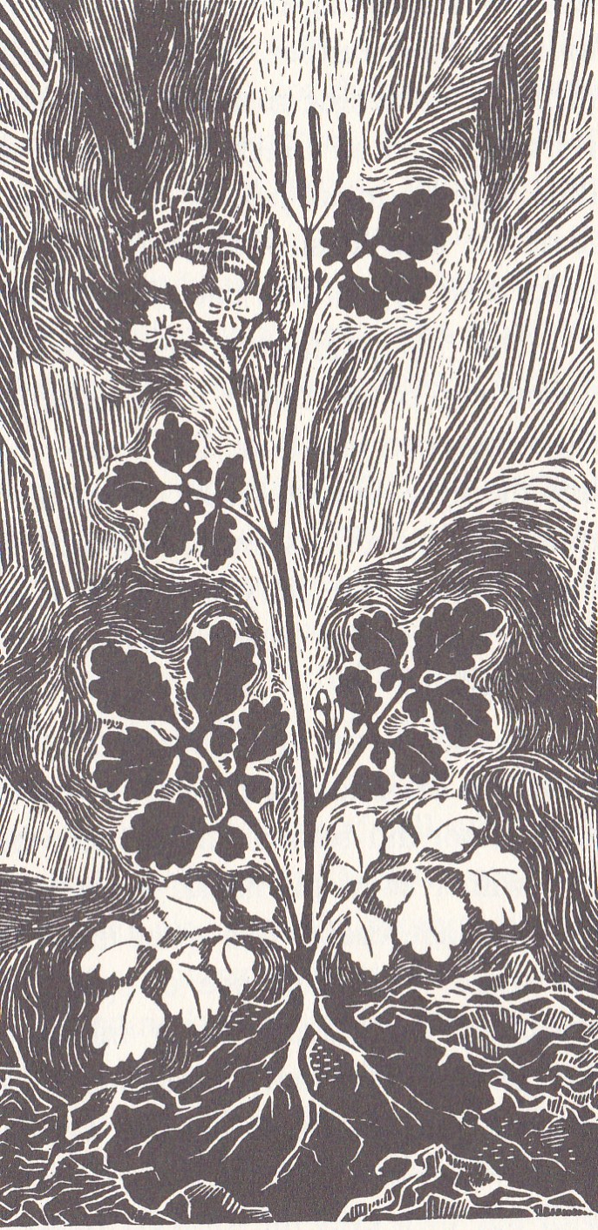
Chelidonium majus

Slide 37
Chelidonium and Homeopathy
“ A perennial plant with a sharp, bitter and burning taste yielding, when pressed, a yellow, corrosive, milky juice. It grows in hedges and waste places amidst stones and rubbish.”
Chelidonium from the Greek word Chelidon which signifies a swallow.

Slide 38
The French herbalist, Messegue, was introduced to it by his father, who said that it was both the best and the most wicked of herbs.
There is a legend that says “it has the power to make you cry if you are going to die and make you sing if you are going to get better.”

Slide 39
Messegue’s father called it Swallowwort and showed him how the swallow took some of the sap to their little ones in the nest to protect them from blindness.
He used it as a diuretic and a purgative, a sedative for anxiety, asthma, bad nerves, chronic bronchitis and allergies but only used it externally in foot and hand baths. He saw it as a marvellous foil to other plants in that it helped with the synergy of prescriptions.

Slide 40
Drawbacks of Chelidonium as a herbal medicine:
the active constituents seem to vary greatly;
the plant product is relatively unstable and has a limited shelf life and is potentially toxic in high dose.

Slide 41
Specific Indications and Uses
"Full, pale, sallow tongue and mucous membranes; skin pale and sallow, sometimes greenish;" hepatic congestion; jaundice, due to swollen bile ducts; sluggish hepatic action; cough, with hepatic pain; fullness, with tensive or throbbing pain in the right hypochondrium, and pain extending to right shoulder; melancholia, headaches, and gastric disorders, dependent upon faulty action of the liver.
Felter, Harvey Wickes, Lloyd, John Uri, King's American Dispensatory

Slide 42
Greater celandine
Habitat
A wild hedgerow plant of Europe, preferring sunny and slightly rocky, sheltered spots.
Botany
Herbaceous perennial. Glaucous finely divided foliage. Bright yellow-orange flower with four petals in a cross shape.

Slide 43
Parts used:
Aerial parts, picked shortly before flowering.
Actions:
Stimulant, acrid, alterative, diuretic, diaphoretic, purgative, and vulnerary.
Latex is bright orange and slightly caustic.

Slide 44
Crude extracts of Chelidonium majus, and purified compounds derived from crude extracts, exhibit anti-viral, anti-inflammatory, anti-tumor and anti-microbial properties.
Chelidonium is used against various liver disorders including cancer in humans.

Slide 45
Fresh latex (juice) when applied to the skin, produces inflammation, and even vesication, and has long been known as a caustic for the removal of warts, indolent ulcers, fungal growths, etc.

Slide 46
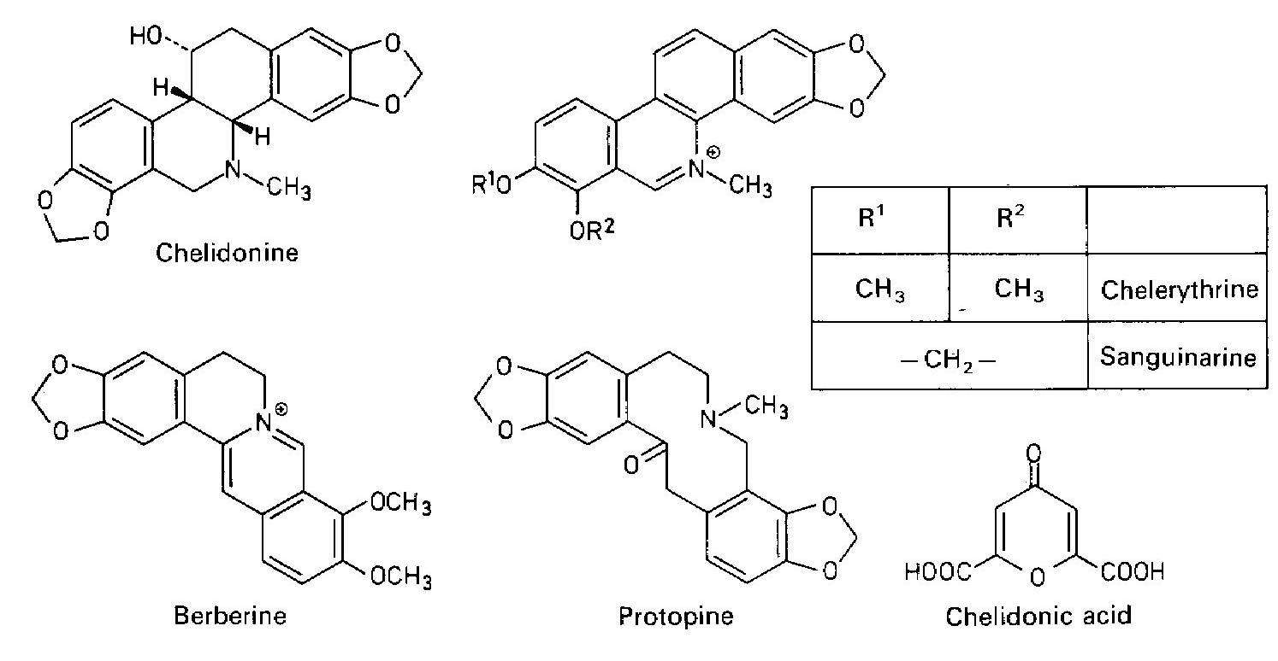
Alkaloids
Chelidonine, chelerythrine, sanguinarine and sometimes protopine.

Slide 47
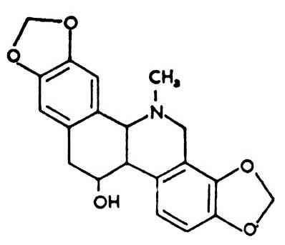
Alkaloids
Chelidonine is a major component in the roots but not in the tops.

Slide 48
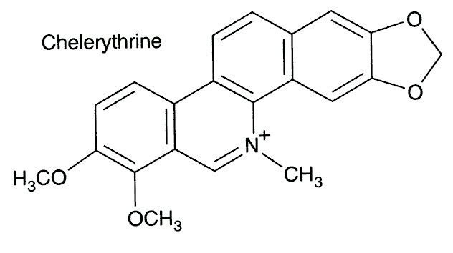
Chelerythrine and sanguinarine are anti-inflammatory with low toxicity and have been recommended for use in the treatment of oral inflammatory processes.

Slide 49
The antiviral activity of Chelidonium root includes activity against the measles virus, inhibition of Herpes virus in vitro and viral ncephalomyocarditis.
Neutralizes influenza virus in vitro.
The more potent thiophosphamide derivatives of chelidonine have been shown to reverse the T-helper cell deficiency and diminish the T-suppressor cell overgrowth in patients with AIDS

Slide 50
Chelerythrine and sanguinarine produced an antifungal effect in vitro against Trichophyton mentagrophytes and T. rubrum, Microsporum canis, Epidermophyton floccosum, and Aspergillus fumigatus.
The activity of chelerythrine was comparable to that of the commercial preparations nitrofungin and myco-decidin.

Slide 51
Indicated for
Migraine, bilious headaches, supraorbital neuralgia, bilious dyspepsia, with headache, and other gastric and intestinal disturbances, due to faulty action of the liver,
Hemorrhoids, hepatic and splenic congestion, and gastro-intestinal disorders, due to capillary engorgement of the viscera,

Slide 52
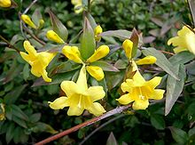

Slide 53
Gelsemium sempervirens in Homeopathy
Gelsemium is a great paralyser of the mind and body. The mind is sluggish, the limbs so heavy one can hardly move them, eyelids droop, double vision and loss of swallowing, tremor is a keynote of the remedy. Works well in flu where chills are playing up and down the spine, legs head and brain are weighty and dull.

Slide 54
Fear of falling, nervous headache with dimness of sight or double vision, especially occipital headaches. A great remedy for measles, palpations.
Gelsemium is useful in neuralgic pain but Weiss considers it to be inferior to Aconite for this.

Slide 55
Therapeutic use of Gelsemium sempervirens
Gelsemine (most abundant), gelsemicine (most active), sempervirine, gelsedine, and hydroxygelsemicine
Powerful effect on peripheral nervous system
Generalized muscle relaxation and reduced sensitivity to pain
Eyelids and jaws droop, strong sense of ease and relaxation

Slide 56
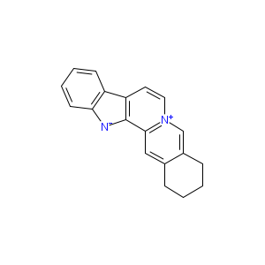
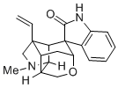
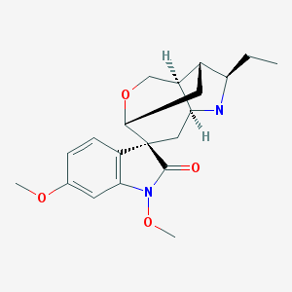
gelsemine
sempervirine
gelsemicine

Slide 57
Central nervous system involvement →
Common symptoms: disequilibrium, diplopia, midriasis, ptosis and feebleness of movement
Pulse may slow to 30 - 40 beats / min, temperature drops
Respiration initially speeds up, then becomes slow and shallow

Slide 58
Large doses → spinal paralysis, complete loss of muscle power, reduction in sensitivity to pain.
Coma may precede death (axphyxia)

Slide 59
Therapeutic applications:
Powerful febrifuge action - especially early stages of fever when there is severe muscle and head pain
Sedative and pain killer
Conditions with bright eyes, contracted pupils, flushed face, great heat and restlessness, mental irritability, insomnia, excitation, hysteria, head pain, nerve pain, chilly sensations upon movement and convulsions

Slide 60
Dosing strategy for Gelsemium
Tincture 1:10, 5 - 15 drops in water, by the spoonful
until physiological effects are noticed
Maximum daily dose 25 mg (0.04 g) of dry root or rhizome, or 0.25 mL of 1:10 tincture 3 times daily.
Maximum weekly dose is 5 mL of tincture.

Slide 61
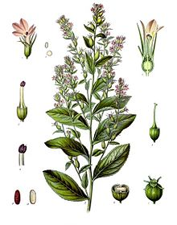
Lobelia inflata

Slide 62
Lobeline
Respiratory stimulant by enhancing reactivity of the brain stem to CO2. ganglionic stimulant.
Lobelanidine & isolobinine – respiratory relaxants and bronchodilators.
Isolobinine is also a strong emetic.

Slide 63
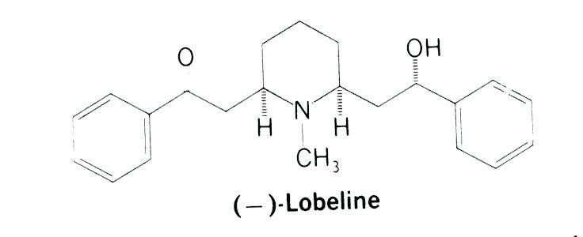

Slide 64
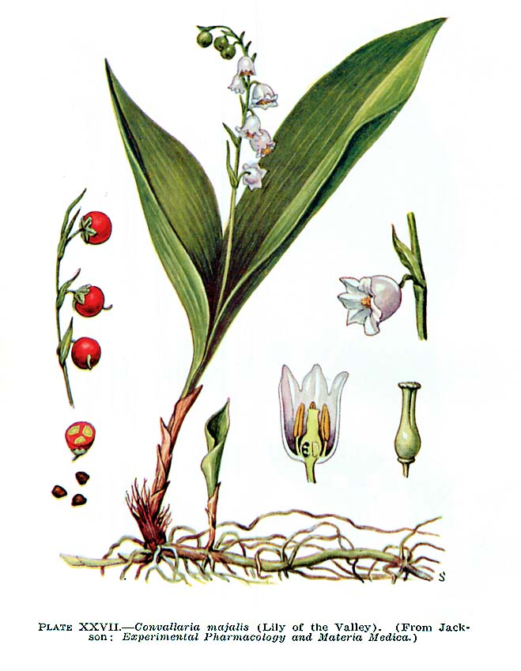
Convallaria majalis

Slide 65
Lily of the Valley
Action: cardiotonic and mildly cardio-seditive. Corornary vasodilator and hypertensive (neither action found in Digitalis).
Uses: Heart failure, myocardial insufficiency, cardiac arrhythmias, oedema of cardiac origin.

Slide 66
Pharmacology
Cardioactive glycosides, especially convalloside in combination with convallotoxin (product of hydrolysis), convallatoxiside with convallatoxol and the saponoside, convallamarine
(Barker, 2001).

Slide 67
Convacard – preparation from the firm Madaus – is a preparation with all the Convallaria glycosides in high concentration. 60% of the preparation consists of the cardiac glycosides, the remaining 40% of substances that have no cardiac activity but play a major role in achieving solubility.

Slide 68
They appear to be precursors or degradation products of the glycosides.
If they are present, the mixture is 500 x more soluble than pure convallotoxin.
These substances are not unnecessary ballast but have key significance for the medicinal action of the whole extract.

Slide 69
Convallaria acts on the heart muscle and not on conduction, making it suitable for bradycardiac forms of heart failure, which are particularly sensitive to digitalis.
Bradycardia is common in senile hearts, when the heart is weakened but performing reasonable well when at rest and not overly stressed. Here Convallaria offers a valuable alternative to Digitalis but cannot replace it when decompensation is severe.

Slide 70
Alongside the glycosides are a whole natural complex of 8 different flavonoids that add considerably to its medicinal properties
(Weiss, 1988).

Slide 71
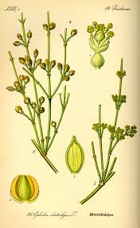
Ephedra sinica

Slide 72
Ephedra sinensis
40 – 90% of total alkaloid content is (-)ephedrine.
Amounts vary a lot between species.
Indirect sympathomimetic effect
Structural analog of adrenaline → triggers release of endogenous catecholamines from post - ganglionic sympathetic nerve fibres → + inotropic action (increases myocardial contractility), broncho-dilation and accelerated respiration, decreased contractility of bladder.
Use for asthma, eneuresis and to increase metabolic rate.

Slide 73
Ephedrine crosses BBB → stimulates CNS →
Improved concentration & memory
Increased rapidity of mental responses
Decreased mental fatigue
Decreased need for sleep
High doses →
Headache, anxiety, tremor, insomnia, redness of faced, nausea, tachycardia, precordial (heart and thorax) pain, sweating, urinary retention and eventually psychosis.

Slide 74
Alkaloids in general
Most complex and varied class of naturally occurring plant constituents. Made by some animals – toads, insects.
Most potent in therapeutic terms.
First plant constituents to be isolated and synthesized.
Morphine made from opium 1803
Synthetic morphine first made in 1952

Slide 75
Amounts in plants vary daily. Synthesis of alkaloids is highest in periods of rapid growth, high sunlight or with nitrogen fertilizers.
Generally, but not always, alkaline and most contain nitrogen. N + 2 or 3 C + H + O
Alkaloids are almost insoluble in water, but are freely soluble in organic solvents such as alcohol, ether & chloroform.

Slide 76
Alkaloids found in Fabaceae, Papaveraceae, Ranunculaceae, Solanaceae & Berberidaceae.
Lamiaceae and Rosaceae families are almost free of alkaloids as are all the Gymnospermae.
Occasionally found in fungi (psilocybin, ergotamine)

Slide 77
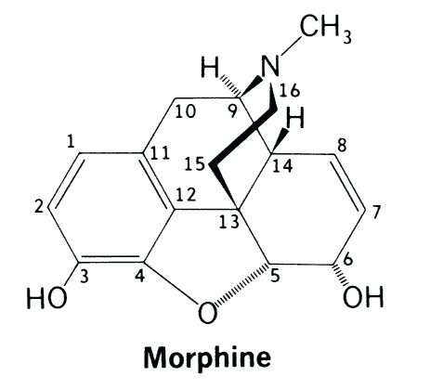
Many allopathic medicines are derived from alkaloids
e.g. morphine, atropine, cocaine, hyoscyamine, quinine, strychnine and pilocarpine

Slide 78
CNS activity:
Depressant e.g. morphine, scopalamine
Stimulant e.g. caffeine, strychnine
Autonomic activity:
Sympathomimetic e.g. ephedrine, caffeine
Sympatholytic e.g. yohimbine, ergot
Parasympathomimetic e.g. pilocarpine
Anticholinergic e.g. atropine, hyoscyamine

Slide 79
Local anaesthetic action e.g. cocaine
Anti-fibrillation activity e.g. quinidine
Anti-malarial e.g. quinine
Anti-tumor e.g. vinblastine, vincristine
Anti-micobial e.g. berberine, hydrastine

Slide 80
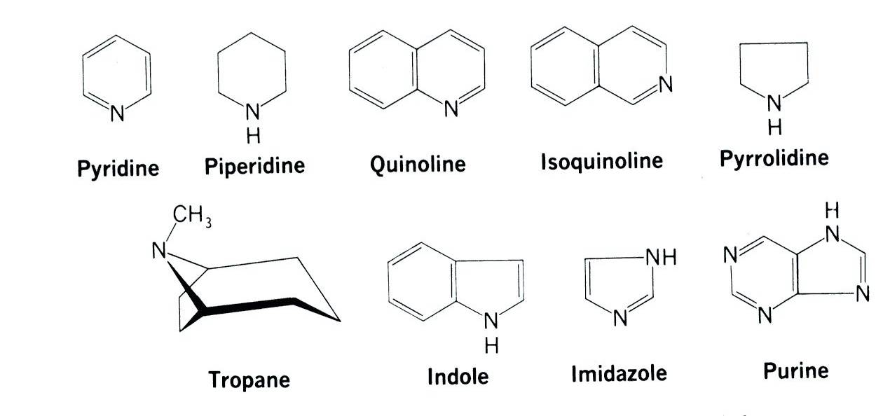

Slide 81
Some alkaloids are only found in one genus e.g. hysoscyamine in Hysoscyamus or only in one species e.g. morphine in opium poppy and others are in more than one family e.g. caffeine in yohimbe and in coffee.
Amounts vary from 3 g vinblastine / metric ton of Catharanthus roseus leaves to 15% quinine in Cinchona bark.

Slide 82
Indole alkaloids
Derivatives of tryptophan
Include the tryptamines and mono amine oxidase inhibitors

Slide 83
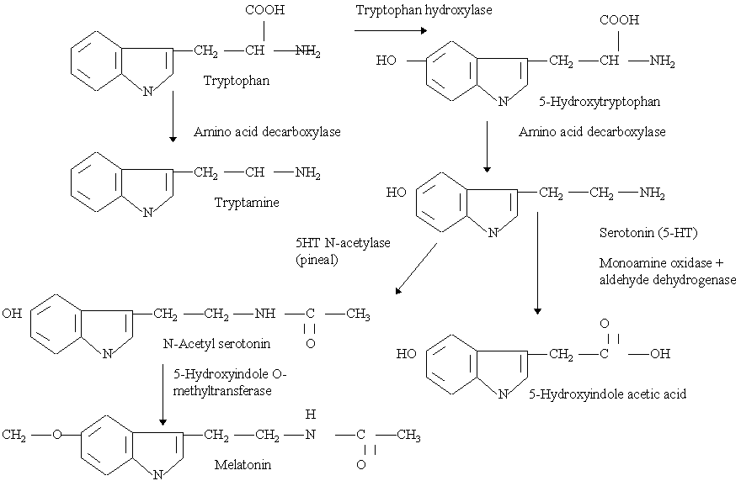

Slide 84
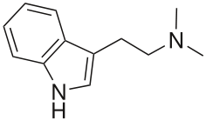
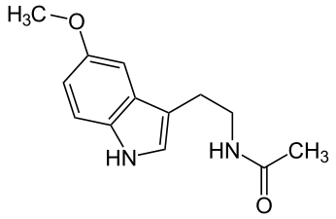
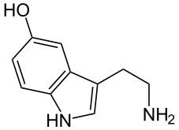
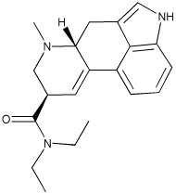
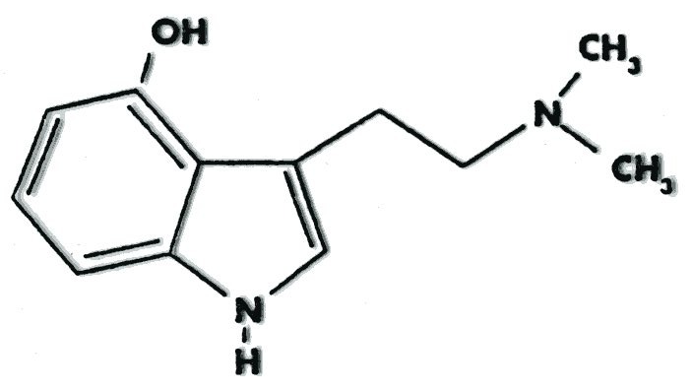
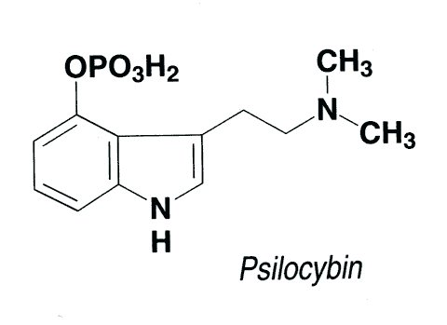
Dimethyltryptamine
Melatonin
Psiloscin
Serotonin
LSD

