Slide 1
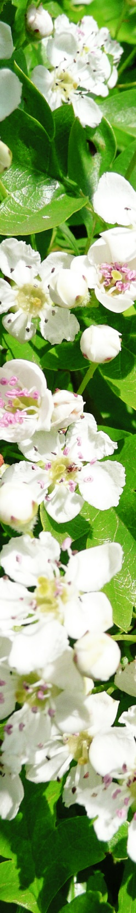
Treating hypertension- key herbs and strategies
Anna Newton BA BSc MCPP

Slide 2
Contents
Introduction
Variety of current statistics and views on hypertension
Myths associated with hypertension
Hypertension as a factor of CVD
Strategies to treat hypertension
Case histories

Slide 3
Introduction
I have been in practice for 13 years
I would like to share my personal experience of treating hypertension (HT) and offer some food for thought in reference to the current orthodox assumptions about HT
I have strong personal interest and connection as both my parents suffered from hypertension

Slide 4
How accurate is our knowledge about hypertension?
“For, medicine being a compendium of the successive and contradictory mistakes of medical practitioners, when we summon the wisest of them to our aid, the chances are that we may be relying on a scientific truth the error of which will be recognized in a few years’ time. So that to believe in medicine would be the height of folly, if not to believe in it were not greater folly still, for from this mass of errors there have emerged in the course of time many truths.”
Marcel Proust, The Guermantes Way, 1920

Slide 5
How accurate is our knowledge about hypertension? Definition
Hypertension is defined as a persistent elevation of blood pressure with systolic blood pressure of 140 mmHg or more or a diastolic blood pressure of 90 mmHg or more, or taking hypertensive medication.
Primary (essential) hypertension – result of environmental and genetic causes (90-95% of cases) – focus of this presentation
Secondary hypertension – result of renal, vascular or endocrine disease (2-10% of cases)

Slide 6
Definitions in different countries
France: blood pressure considered normal if below 140/90 mmHg
Sweden: if diagnosed with diabetes II, hypertension starts at 130/90 mmHg
Poland: gentle hypertension 140-159/90-99 mmHg
USA: normal if below 120/80 mmHg
prehypertension 120-139/80-89 mmHg
Stage 1 - 140-159/90-99 mmHg

Slide 7
Global perspective – prevalence of hypertension, % , in selected countries
According to WHO bulletin January 2014 (age group 35-84, data from national surveys):
Bangladesh 19.6
Thailand 24.5
Mexico 29.5
Great Britain 31.2
South Africa 32.7
Japan 31.8 (in 1960 it was 40%)
USA 34.5
Russia 43.6
Germany 44.8

Slide 8
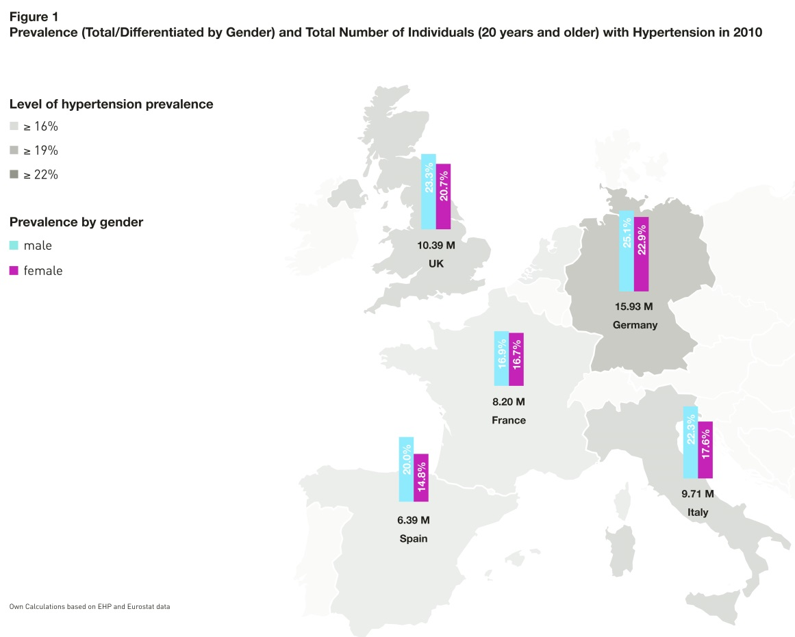
Burden of hypertension in selected EU countries
Source: www.kantarhealth.com

Slide 9
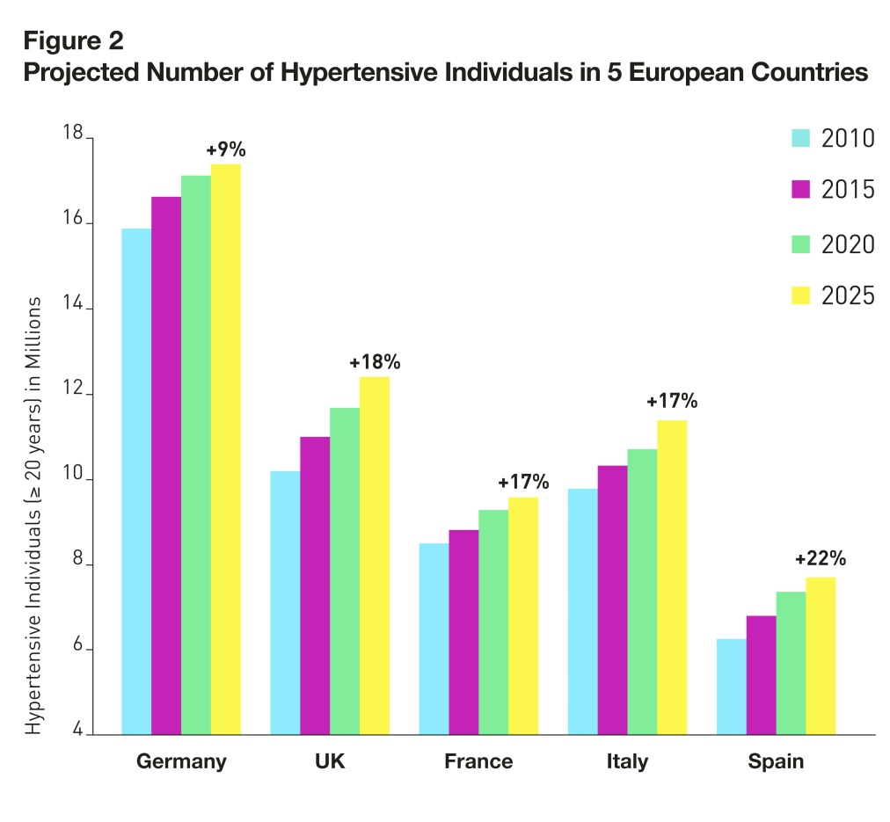
Burden of hypertension in selected EU countries

Slide 10
Burden of hypertension in selected EU countries
The projections show a considerable increase in the prevalence of hypertension: the total population of the 5 biggest EU countries will grow by 5.7% but the number of people with hypertension will increase by 15.3%. This projection partially reflects the effect of the EU population aging.

Slide 11
Some myths about hypertension
Once you started on hypertensive medication you have to stay on it for life (not true – lifestyle changes/herbal treatment can reverse it)
Only Western countries have the problem (not true – it is a global problem)
Low intake of salt will reduce your hypertension (not true – only in a proportion of people high salt intake will induce hypertension)
Thiazide diuretics reduce your blood volume in the long term (not true – the mechanism of long term action is poorly understood and seems to involve vasodilation)
Low fat diet will prevent hypertension (not true – low fat diets lead to imbalance of lipid profile and often cause obesity)

Slide 12
Some myths about hypertension
You are OK if your lower systolic blood pressure (not true – both numbers need to be reduced and pulse pressure should be around 40 i.e. SBP 120 – DBP 80 = 40)
Only orthodox medication can lower hypertension (not true – lifestyle changes can be as effective)
Complementary medicine cannot help with hypertension (not true – many modalities will help, some indirectly by e.g. reducing the stress level)
If you are genetically predisposed to hypertension, there is nothing you can do to prevent it (not true – lifestyle modifications can prevent hypertension)

Slide 13
Hypertension as a factor in the cardiovascular disease (CVD)
There are many factors contributing to CVD :
smoking
poor diet
obesity
co-morbidities as diabetes I or II
cholesterol levels
high homocysteine levels
hypertension
high insulin and insulin resistance
Sleep apnea
ethnic origin
level of deprivation (social and wealth)

Slide 14
Hypertension as a factor in the cardiovascular disease (CVD)
There is limited consensus among the medical profession which factors are most important and the target figures for many factors keep on changing
Medical profession relies on algorithms to estimate the CVD risk of individuals, often pressurising the patients to take up orthodox treatment

Slide 15
Hypertension as a factor in the context of an algorithm
Let’s have a look at a specific algorithm:
QRISK®2-2015 risk calculator: http://qrisk.org
This is an example of an algorithm that is used widely in NHS to calculate the risk of a heart attack or stroke within the next 10 years from the point of entering the data.

Slide 16
Hypertension as a risk factor in the context of the algorithm QRISK®2-2015
AGE: 58
SEX: F
ETHNICITY: White
UK POSTCODE: GL50
SMOKING STATUS: x
DIABETES STATUS: x
ANGINA/MI IN A RELATIVE: x
CHRONIC KIDNEY DISEASE: x
ATRIAL FIBRILATION: x
ON BLOOD PRESSURE MEDS: x
RA: x
CHOLESTEROL/HDL RATIO: 3.5
SYSTOLIC BLOOD PRESSURE: 115
BODY MASS INDEX: 20kg/m²
My risk over 10 years with the above values: 3.1%
My risk over 10 years if my SBP was 150 mmHg: 4%
My risk over 10 years if my SBP was 140 mmHg and I was on blood pressure medication: 5%

Slide 17
Hypertension and lifestyle factors
The problem with such algorithms is that they are too simplistic, often out of date and do not take into consideration the protective lifestyle factors.
For instance, it has been shown that:
BMI is not as relevant as the actual waste size (should be less than 94cm if you're a man and less than 80cm if you're a woman, or even more importantly the waste-to-hip ration should be less than 1 in men and less than 0.85 in women)
Both systolic and diastolic BP matter in equal measure (has been shown in numerous studies in the 90-ies)

Slide 18
Hypertension and lifestyle factors
Pulse pressure (SBP – DBP = PP) has been shown to be a powerful risk marker, especially for elderly patients, therefore patients with isolated systolic HT are at greater risk for cardiovascular events than those with combined systolic and diastolic hypertension
Diet matters hugely e.g. consumption of coffee and alcohol, trans-fats, low Mg, intake of vegetables, levels of vit D
Lack of exercise increases your risk of both hypertension and CVD
Homocysteine increase is linked to hypertension (high homocysteine levels have been linked to meat based diet and/or vit B12/folate deficiency)

Slide 19
Hypertension and lifestyle factors
The composition of microbiome influences blood pressure
Kim S. et al, J Hypertesion, 2015 June “Hypertensive patients exhibit gut microbial dysbiosis and an increase in Th17 cells” observed:
Marked decrease in microbial richness and diversity in the HT patients compared to normotensives
700% in Th17 cells compared to normotensives (levels of these cells are regulated by the gut-intrinsic mechanisms that generate pro-inflammatory cytokines such as TGF- β1, TNF-α , IL-1β, IL6)
Conclusions: Gut microbial dysbiosis plays a key role in HT and the establishment of a systemic proinflammatory status through regulation of Th17 cell levels

Slide 20
Hypertension – target values
Prior to 1970 blood pressure of 170/110 was noted by a GP but not treated – today that would be treated as emergency needing immediate treatment
Recently the target in Europe and USA has been 140/90 mmHg
Lower target for patients with diabetes: 130/80 mmHg
Higher targets for patients over 60: 150/90 (recommended by the 8th Joint National Committee JNC 8 in 2013)

Slide 21
Hypertension – target values
Most recent large study SPRINT (Systolic Blood Pressure Intervention Trial) across 100 clinics in USA and Puerto Rico has found by 2015 that lowering SBP to 120 or less in high-risk hypertensive adults was associated with 30% reduction in the cardiovascular events and 25% of all mortality. This required the patients to be on 3 or more hypertensive medications (diuretic chlorthalidone, calcium channel blocker amlodipine, ACE inhibitor lisinopril)
(the study has not been published yet but the trial was stopped 2 years short of the original duration as the benefits were so clear)

Slide 22
Strategies to treat hypertension
Offer advice on lifestyle changes
Offer advice on diet
Offer advise on supplements
Prescribe appropriate herbs
Monitor progress

Slide 23
Strategies to treat hypertension- advice on lifestyle changes
Stop smoking
Reduce alcohol consumption to a very occasional drink
Aim to walk/cycle/garden for at least ½ hour a day, every day (exercise outside is much more beneficial as sun exposure activates vit D)
Make time for relaxation
Aim for a healthy weight and waist size

Slide 24
Strategies to treat hypertension – advice on diet
Eat 7-10 different vegetables/fruit a day
Eat healthy fats (olive oil/coconut oil, organic butter)
Eat wild/organic fish in preference to meat (3 x a week) or become a vegetarian (eating variety of grains and pulses, not just wheat based pasta)
Eat organic food
Avoid coffee (but green tea is OK)
Reduce the simple carbohydrate load
Avoid any foods with trans-fats

Slide 25
Strategies to treat hypertension – advice on supplements
Omega 3 EFA (e.g. evening primrose oil or fish oil – careful with anti-coagulants)
Turmeric - (careful with anti-coagulants)
Mg, vit D
Aloe vera gel
Folic acid (if high homocysteine)

Slide 26
Core herbs to treat hypertension
Crataegus oxyacanthoides/monogyna (flowering tops)
Valeriana officinalis
Tilia x europea
Viburnum prunifolium
Achillea millefolium
Allium sativum Garlic standardized or juice, limited time
Ginkgo biloba
Viscum album (mistletoe)
Eleutherococcus senticosus/adaptogens/adrenal tonics
Aloe vera gel
Curcuma longa (turmeric)

Slide 27
Core herbs to treat hypertension
Crataegus oxyacanthoides (flowering tops) – large dose, 40ml per week at least
Valeriana officinalis – 1:1 to reduce the stress
Tilia x europea - vasodilator
Viburnum prunifolium – vasodilator, smooth muscle relaxant
Achilea millefolium - vasodilator
Allium sativum - standardized capsules or juice, improves elasticity of the arteries, two months in a row max otherwise the gut flora becomes effected

Slide 28
Core herbs to treat hypertension
Ginkgo biloba – peripheral vasodilator
Viscum album (mistletoe) – small dose, for a month or two, it is supposed to have a negative inotropic action
Eleutherococcus/adaptogens/adrenal tonics (careful with licorice as it can raise blood pressure, generally 10-15ml of 1:2 is fine) – all to counterbalance the effects of stress
Aloe vera gel 5-10ml per day – to improve the health of the microbiome
Curcuma longa (turmeric) – general anti-inflammatory to reduce the systemic inflammation

Slide 29
Strategies to treat hypertension- monitor progress
Repeat visit every 2-3 months (I run 10 min appointments for that) until blood pressure stabilises at the desired level
Aim to come off the herbs in the longer term

Slide 30
Treating patients on orthodox medication
Most common issues:
Side effects of the orthodox hypertensive medication (gout, skin rashes, dry cough)
BP still poorly controlled
Patients taking anti-coagulants – there are contraindications for specific herbs and some supplements (start on low doses and monitor INR)

Slide 31
Case history 1
Mrs W., age 73, first seen 2004
Initially came with hot flushes and moderate hypertension (150/90)
History of HRT for 10 years and recent hysterectomy due to fibroids
Very active physically and having good diet

Slide 32
Case history 1
Initial prescription:
℞1
Crataegus oxycantha 25
Achillea millefolium 15
Viburnum opulus 10 Sig 7.5ml bid
Hypericum perforatum 20
Cimicifuga racemosa 30
℞2
Garlic juice 200ml Sig 5ml a day

Slide 33
Case history 1
Blood pressure stabilised over next few months to the average 125/85, occasionally going up to 140/90, a course of garlic juice normally brought the pressure down
In 2014 I added a prescription for improved thyroid function plus meadowsweet tea (1 cup a day) plus the patient started taking Aloe vera gel (5-10ml a day)
℞3
Withania somnifera 35
Ginkgo biloba 15
Harpagothytum p. 15 Sig Initially 5ml, tds then 5ml 1 x day
Eleuthrococcus s. 20
Fucus vesiculosus 20

Slide 34
Case history 1
The patient has been taking the same blood pressure regulating mix for the last 5 years as below:
℞4
Valeriana officinalis 1:1 15
Achillea millefolium 15
Crataegus oxycanth. 45 Sig 5ml, 1 x day
Tillia x europea 15
Viburnum prunifolium 15

Slide 35
Case history 1
Last visit August 2015
Blood pressure 110/70
Decided to prescribe only Crataegus at 2-3ml/day
Continue with Aloe vera, meadowsweet tea and the thyroid function mix (the patient notices the difference in her energy level when not taking the latter)

Slide 36
Case history 2
Mrs S., 58 years old
Initially consulted in 2008 with extreme anxiety
Overweight, occasional psoriasis, prone to sinus infections for which she took antibiotics repeatedly, phobia of hospitals and of orthodox medication except for antibiotics, symptoms of dysglycemia
March 2015: the patient had her blood pressure taken at the GP’s - 190/100 (second reading 160/96)
Pressurised to take hypertensive medication immediately

Slide 37
Case history 2
Initial prescription for hypertension
℞1
Lavender off. 5
Valeriana off.1:2 25
Zizyphus spinosa 25 Sig 10 ml tds
Crataegus oxy. 20
Tilia europea 30

Slide 38
Case history 2
The patient has been asked to come to the GP’s surgery for a repeat blood pressure measurement, which made her panicky, I increase the dose of the anti-anxiety mix
℞2
Astragalus mem. 20
Ribes nigrum 15
Borago off. 15 Sig 10 ml tds
Melissa off. 25
Passiflora inc. 20

Slide 39
Case history 2
May, 2015: the patient went for a repeat blood pressure measurement and it was 140/90
The patient made resolution to loose weight, added blood sugar regulating mix
℞3
Galega officinalis 40
Gymnema sylvestre 40
Silybum marianum 20 Sig 2.5 ml bid

Slide 40
Case history 2
September, 2015: the patient lost some weight
Blood pressure remains around 140/90
There is an ongoing very stressful situation in her life but she copes quite well on the herbal mix

Slide 41
Conclusion
Herbalists can offer effective and safe treatment
The understanding of hypertension is changing continually and should inform our treatment
Herbalists are early adopters of scientific findings and can adapt their traditional prescribing to the latest research

