Slide 1
Food intolerances,
diagnosis and solutions
Christine Herbert FAMH, Dip AET, BA(Hons)

Slide 2
Why do we need to diagnose food intolerances?
Most chronic ill health involves a food intolerance
Removing a specific food group can solve a lot of health issues by itself.
Faster resolution, better for patients.

Slide 3
Definitions
food intolerances or sensitivities - inability to digest certain foods which causes chronic, non life threatening symptoms such as diarrhoea, bloating, heartburn, constipation - cause inflammation leading to chronic disease, may be IgG reactions, not always immunological
food allergies - immune system sees the food as a major threat, resulting in potentially life threatening allergic responses such as hives, vomiting, diarrhoea and drop in blood pressure. Such as nut allergies. These would usually be IgE anaphylactic type allergies
Coeliac disease - somewhere in between – autoimmune reaction with gluten triggering severe gut inflammation and diarrhoea

Slide 4
Food intolerance testing
guess at the most likely cause from the symptom pattern or from any known history in the family, and remove it for long enough to observe any changes. This is the elimination method. A food diary can be very helpful with this approach. Elimination is very accurate in the end, but it is long winded, and people can get very fed up if it takes a long time. It also may not find all food intolerances if these are multiple.
pulse test – when a substance is ingested that upsets the body very often there is a rise in pulse. So take a pulse rate before and after ingestion of the test substance.
Dowsing can be very accurate with experience
Vega testing, where electro-magnetic skin conductivity is measured. In experienced hands this can also be accurate.
sway test – useful in the supermarket
It is also sometimes possible to put a small amount of the substance on the skin, make sure it stays there (with a small bandage for example) and observe for any reddening of the skin over some hours. This last method works if someone has an IgE allergy, but I don’t think it is so sensitive otherwise.

Slide 5
Food intolerance testing
muscle testing/applied kinesiology. a method of asking the body what it likes and doesn’t like and results are very clear. The food that comes up as a problem can then be removed from the diet with more certainty than the elimination method, and if digestive symptoms improve then all is good. It just makes everything quicker and easier.
Commercial testing of blood for antibodies to specific foods. This looks at specific IgG antibody presence in the blood to known food allergens by enzyme or fluorescence linked immunosorbent assays; sometimes this also tests for IgG4 binding too. The higher the binding the more the patient is intolerant to that food. However this may well be a normal response to eating that food, especially IgG4, and especially when the food has been recently eaten. All food is “foreign” and liable to create an immune response.
My experience with seeing the results of IgG food intolerance testing has not been favourable. Many more foods appear as positive results than are actually a problem to the patient.
This is backed up by the results of a study on 100 children with ADHD where diets were based on IgG testing and found to be misleading, although elimination diets were helpful when not based on IgG testing.
L.M.Pelsser et al Effects of a restricted elimination diet on the behaviour of children with attention-deficit hyperactivity disorder (INCA study): a randomised controlled trial. Lancet. 2011 Feb 5;377(9764):494-503.

Slide 6
Food intolerance testing in my clinic
Four pronged approach
Detailed medical history
Clinical observation
Muscle testing
Specific food elimination

Slide 7
Diagnosis
It is not always necessary to have digestive symptoms with a food intolerance, symptoms could include sleep disturbance, skin rashes, bladder irritation, mood swings or even general body heat.
Single food group intolerances generally can be recognised from symptom patterns – can be diagnosed from these then backed up by muscle testing and/or dowsing, then elimination from the diet for at least three weeks. Take a detailed symptom picture so you can compare 3-4 weeks later – often people forget how bad things were. Sometimes there are withdrawal symptoms – can be quite acute stomach pains, headaches, mucous clear out – if very bad then withdraw from diet slowly. These tend to be the ones who have really hammered that food
For patients reporting little or no improvement – interview on follow up appointment:
how are you today
no improvement, waste of time, still feel awful
ok – how about your sleep/indigestion/ bowels/ bladder/ bloating......(which you had got them to be very specific about at the first appointment – could even be scored on a 1-10 basis)
Ah – I forgot about that – yes that is a bit better actually
How much better...…

Slide 8
Symptom patterns
If someone has a lot of mucus and phlegm, with catarrh, sinus congestion, asthma, continual throat clearing and a history of tonsillitis and/or ear infections, sometimes with seasonal hay fever, then dairy exclusion is the first thing to try. This is also the case with hormonal imbalance or disease, for men and women.
If there is a pattern of repeated urinary tract infections, and maybe bladder irritation or a history of bedwetting, then dairy is also likely, but salicylate sensitivity has to be considered too.
A history of headaches with constipation and sometimes joint stiffness and pain, and skin rashes can suggest nightshade sensitivity.
Wheat and gluten sensitivity can show symptoms of skin rashes, and often upper GI T symptoms eg reflux, also digestive problems such as diarrhoea or bloating.
None of these are definitive pictures of a food sensitivity or intolerance, but they can guide you to eliminating a particular food first, which will save time and stress.

Slide 9
primary/secondary intolerances
Sometimes people will have a primary intolerance, and one or more secondary ones. Here it is important to find the primary one – usually from the medical history . Once that has been removed from the diet the secondary ones will often resolve once the gut is healed. If the secondary intolerance is a food it will be necessary to remove it temporarily; however often it will be an environmental allergen such as pollen, cat or dog hair, house dust or moulds. If the latter group don't resolve with removal of the primary allergen then it might be helpful to organise homeopathic desensitisation to that substance.
complete withdrawal is needed for at least 3-4 weeks – some people will have improvement if they remove 90% of the food, and they will decide that they are happy with that. When they have no stressors in their life that might be fine, but they need to be informed that things could get worse when stress is involved
In my experience, virtually everyone who has a chronic inflammatory condition has a food intolerance to some extent or another.

Slide 10
Common intolerances
The foods and food groups to which someone is intolerant could include:
animal milk products ie dairy
wheat and/or gluten grains
nightshade family foods, tomatoes, potatoes, peppers and aubergines
soya based foods
high salicylate foods
high oxalate foods
high histamine foods
high lectin foods
eggs
But anyone can be intolerant to anything…..

Slide 11
Dairy intolerance
the most common intolerance – at least 75% of all intolerances. Occasionally lactose , mostly (>90%) casein – never seen dairy fat. If lactose then they may be able to tolerate lactose free milk/cheese etc. Common misconception about lactose – generally it is the dairy proteins that cause the problem not lactose although occasionally children are lactose intolerant. Most dairy intolerant people can eat small amounts of butter. Possible indications include:
ear infections – often in childhood
tonsillitis – often in childhood
asthma – can be in childhood
chest infections
sinusitis/sinus infections/blocked nose/snoring
hayfever
cat/dog allergy
bladder irritation/infection
kidney stones/infection
gallstones – history of cholecystectomy
fatigue/muscle pains
digestive – bloating, wind, diarrhoea, constipation - IBS
sleep restlessness, insomnia
joint pains
menstrual problems – menorrhagia, PCOS, endometriosis, dysmenorrhoea, infertility
menopausal hot flushes
high blood pressure
breast and prostate cancers
BPH – enlarged prostate
general inflammation – which can cause all sorts of chronic disease including autoimmune disease, heart disease, cancer etc

Slide 12
Salicylates + oxalates
this is becoming more common – maybe 20-25% of people I see are salicylate intolerant, and 15 years ago it was only occasional. Probably more common as people are eating berries out of season, and turmeric as supplement. It often appears with dairy intolerance, and sometimes it will only show up with testing once dairy has been removed from the diet. Always suspect salicylate intolerance if symptoms don't improve once the initial suspect food has been withdrawn (assuming it has been 100% withdrawn). High salicylate foods need to be reduced.
All berries especially strawberries, almonds, chamomile, mint and liquorice are good indicator foods.
A common finding is a reaction by a patient to a high sal herb in a formula - eg elderflower, chamomile, rose, schisandra, liquorice, meadowsweet
Possible indications include:
skin redness and irritation
bladder irritation
digestive problems
diarrhoea
constipation
aspirin intolerance
oxalates
similar cause/indications to salicylates
often linked with oxalate kidney stones – not common
high oxalate foods include spinach, rhubarb, buckwheat, berries, kale

Slide 13
wheat/gluten
both gluten and wheat are inflammatory to everyone and will make symptoms of other intolerances worse. Any gut irritation or chronic inflammatory disease needs reduction of all inflammatory foods (wheat, dairy, tea, coffee, alcohol, oranges, pork, sugar). Autoimmune folk need GF.
Need to check all the gluten grains too – oats, rye, barley, spelt.
Some wheat intolerant people can cope with spelt and/or kamut or emmer grain/flour. Possible indications include:
skin involvement – usually eczema, can be from childhood
upper digestive tract issues – heartburn, indigestion
lower digestive tract - constipation, diarrhoea, bloating, wind - IBS
joint pains – often later in life
acne rosacea
fatigue/muscle pains
general inflammation – which can cause all sorts of chronic disease including autoimmune disease, heart disease, cancer etc

Slide 14
lectins
Foods containing high amounts of lectins can cause problems for some people, especially if they already have some gut damage. High lectin foods are mostly seeds.
High lectin foods include most grains and legumes - so that includes wheat, rice, barley, quinoa, soya, lentils, kidney beans, chickpeas. In this group of foods, lectins are greatly reduced by adequate soaking, cooking or sprouting. Undercooked legumes are difficult to digest, and cause a reaction, which can be severe, in many people.
Other high lectin foods include sunflower and pumpkin seeds, cashews, peanuts, and the nightshade family group (tomatoes, aubergines, potatoes, chillies, sweet peppers) and also cucumbers. Lectins are greatly reduced in cucumbers and nightshades when they are peeled and deseeded.

Slide 15
Nightshades
Potatoes, tomatoes, aubergines, sweet and hot peppers, tobacco
Solanacaeae – the toxins appear to affect just certain people – no more than 5% of the population. The effect of the toxins seems to be to create a rigidity /inflexibility of body tissues. This is the one intolerance that doesn't respond to removing the offending food very quickly – there may be small improvements but most symptoms take a few months to improve. Possible indications include:
headaches
constipation
joint pains/arthritis
high blood pressure
skin rashes in children
general inflammation – which can cause all sorts of chronic disease including autoimmune disease, heart disease, cancer etc

Slide 16
Soya
Often seen in those who have stopped dairy and simply swapped dairy for soya. Always warn anyone you diagnose with dairy intolerance. Soya is very allergenic. Fermented soya (soy sauce, tofu, tempeh, miso) is not as bad as unfermented (modern processed soya products – milk , cheese, etc). Possible indications include:
bloating, wind, diarrhoea, bowel urgency
fatigue
general inflammation – which can cause all sorts of chronic disease including autoimmune disease, heart disease, cancer etc

Slide 17
histamine
very variable - cumulative reaction to a combination of factors:
consumption of too much histamine provoking foods - fermented, aged, long cooked, smoked, pickled foods -avoid fermented foods and bone broths
consumption of drinks that prevent histamine breakdown in the body - alcohol blocks the enzyme DAO that degrades histamine
use of medications that prevent histamine breakdown in the body eg aspirin, ibuprofen, metformin, propanolol
too much sun, or over exertion in the gym
wrong gut bacteria – some will breakdown histamine in the body, some will add histamine
Histamine intolerance HIT is dose-dependent - occurs when the rate of histamine accumulation exceeds the capacity of histamine degradation - usually a failure to degrade histamine

Slide 18
Histamine
Common symptoms associated with histamine intolerance :
• Skin rashes, itchiness • Eczema • Urticaria • Acne
• Asthma
• Cardiac arrhythmia, such as a fast beating or irregular heart beat
• Low blood pressure
• Sudden psychological changes (e.g. aggressiveness, inattentiveness, lack of concentration)
• Anxiety/depression • Sleep issue (insomnia / early waking)
• Irritable bowel syndrome (constipation / diarrhoea) • Flatulence and feeling of fullness
• Stomach cramps /stomach ache • Nausea / vomiting
• Flushing of face and /or chest (very common symptom) • Headaches / migraine
• Runny nose and weepy eyes (with no clinical sign of allergies)
• Dizziness
• Extreme tiredness, fatigue (often feeling cold/shivery)
• Oedema (swellings mostly appearing around eyes and lips, sometimes in the area of the throat)
• Dysmenorrhoea
• symptoms go away during pregnancy and return after birth of child

Slide 19
Histamine
Quercetin and Stinging Nettles: these are natural antihistamines, that do not block DAO and are very effective in preventing histamine reactions and calming mild to moderate reactions. Dose: 250 mg quercetin or isoquercetin three times daily; quercetin should not be used in pregnancy or if you have kidney disease. Use nettles as a fresh tea or in powder form.
Quercetin is found in red onions, red grapes, apples, dark leafy greens and cruciferous vegetables
methylated B vitamins seem to aggravate some people with histamine intolerance
Probiotics and Prebiotics: A daily combination of both a probiotic and a prebiotic helps to repair the intestinal wall, however, avoid probiotics with Lactobacillus casei, or L. bulgaricus, may increase histamine. Lactobacillus rhamnosus, Bifidobacterium infantis and B. longum are the most useful.
OPCs oligomeric proanthocyanidins – have anti histamine properties – found in high concentrations in apples, pears, grapes, chocolate, wine and tea.

Slide 20
Multi sensitive people
Always worse with stress, and always changing.
Vary their foods, never eat the same thing every day
Pacify Vata (breathing/yoga, calm, no stimulants, no raw food)
These are the people who say they can only eat three different foods, and they can't go out to eat
Usually a primary, original food intolerance that they have ignored, and this has gone on to cause such irritation of the gut that they end up with a leaky gut and a very weak and inflamed digestive system plus poor metabolic/liver function.
Determine the intolerances, work out the primary if possible - remove from diet
remove most other inflammatory foods (gluten, sugar, pork, oranges, tea, coffee, alcohol);
treat the leaky gut (althaea, agrimonia, calendula, L-glutamine);
remove NSAIDS if they are taking them; treat dysbiosis; treat liver
give probiotics or fermented foods - caution with histamine
digestive spices and/or bitters to improve digestion; caution with herbs, they may react, use drop doses
Vit D and omega 3's increase the reactivity threshold and are anti inflammatory;
alteratives and lymphatic herbs suitable for the individual to clean up the body so it can get working again.

Slide 21
Leaky gut and inflammation
Chronic inflammation-> tight junctions between GI cells widen, allowing larger molecules to pass through = foreign antigens -> triggers immune system to start inflammatory process and create antibodies against them -> new inflammation creates yet more food sensitivities.
food sensitivities are a cause of, and a result of, increased intestinal permeability.
Digestive capacity decreases -> bloating, reflux, gas and feelings of fullness
Impact on microbiome, liver, nutrient availability for the immune system, chronic inflammation

Slide 22
Leaky gut and inflammation
Bacterial endotoxin = lipopolysaccharide LPS from cell walls of gram negative bacteria found in large numbers in the gut, the gums and other tissue when there is bacterial infection or dysbiosis. When they remain in the intestines they don’t cause a problem, but when the bacteria die off and there is a degree of gut leakiness, then the released LPS can move through the intestinal wall and into the bloodstream where they will initiate inflammation. There is evidence to show that this process is important in the development of inflammation linked with obesity and diabetes, and may be a major cause overall of chronic inflammation
P.D.Cani, et al Metabolic endotoxemia initiates obesity and insulin resistance. Diabetes. 2007 Jul;56(7):1761-72.
LPS cross blood-brain barrier -> neurodegeneration
G.C. Brown The endotoxin hypothesis of neurodegeneration. J Neuroinflammation 16, 180 (2019). X.Peng et al Blood-Brain Barrier Disruption by Lipopolysaccharide and Sepsis-Associated Encephalopathy. Front Cell Infect Microbiol. 2021 Nov 4;11:768108
The liver also involved in this as it has to detoxify LPS from the bloodstream. When the liver is compromised it cannot produce enough bile which is needed to control gram negative bacteria in the colon, resulting in more LPS production, more leaky gut and a vicious circle.
Involved in development of autoimmunity, all inflammatory gut disorders
Cardamom significantly decreases secretion of inflammatory mediators secreted by lipopolysaccharide-stimulated macrophages.
M.Souissi et al. Antibacterial and anti-inflammatory activities of cardamom (Elettaria cardamomum) extracts: Potential therapeutic benefits for periodontal infections. Anaerobe. 2020 Feb;61:102089.

Slide 23

solutions
Alteratives -
a true alterative/depurative herb is one that not only cleanses and detoxifies, but also facilitates proper nutrient assimilation and which has a normalizing action on overall physiology
Ed Smith http://www.herbaled.org/Education/Articles/alteratives2.html
Achillea, agrimonia, arctium, berberis, calendula, carbenia, cynara, rumex, taraxacum…
From an Ayurvedic viewpoint allergy or intolerance is only possible if the body, and particularly the digestion, is weak. Ayurveda teaches that with strong digestive fire there will be no allergy so treatment will be to rectify this. Hence trikatu, the pungent heating digestive mix of ginger, long pepper and black pepper; aniseed can be used instead of long pepper which cools it a bit, or
cooling and clearing herbs are needed such as coriander, aloe vera juice, gentian and fennel. Also bitters (more later).

Slide 24

Treating the gut
Healing a leaky gut must commence with a good diet, with no inflammatory foods.
Mucilaginous polysaccharides such as Aloe vera, marshmallow root Althaea officinalis, and slippery elm Ulmus fulva, and seaweeds to improve mucosal health.
Garlic Allium sativum is a prebiotic, and is antimicrobial towards the pathogenic microorganisms.
Lions mane Hericium erinaceus is a fungus that has long been used in traditional Chinese medicine to treat gastrointestinal inflammation, and recent studies have shown it can improve leaky gut. X-Q.Xie et al. Influence of Short-Term Consumption of Hericium erinaceus on Serum Biochemical Markers and the Changes of the Gut Microbiota: A Pilot Study. Nutrients. 2021; 13(3):1008.
Marigold Calendula officinalis and plantain Plantago spp. are both inflammation mediating herbs excellent at wound healing. A strong decoction of the dried or fresh herbs can be made by simmering for 20-30 minutes, drink on an empty stomach first thing am. a handful of the dried herb in about 250ml of water
Bone broths, when long cooked, release collagen peptides that support the repair of the intestinal wall. Caution with histamine.
Gum acacia appears to be able to heal damaged tissue, possibly by supporting that part of the microbiome that improves tight junctions in the intestinal lining.

Slide 25
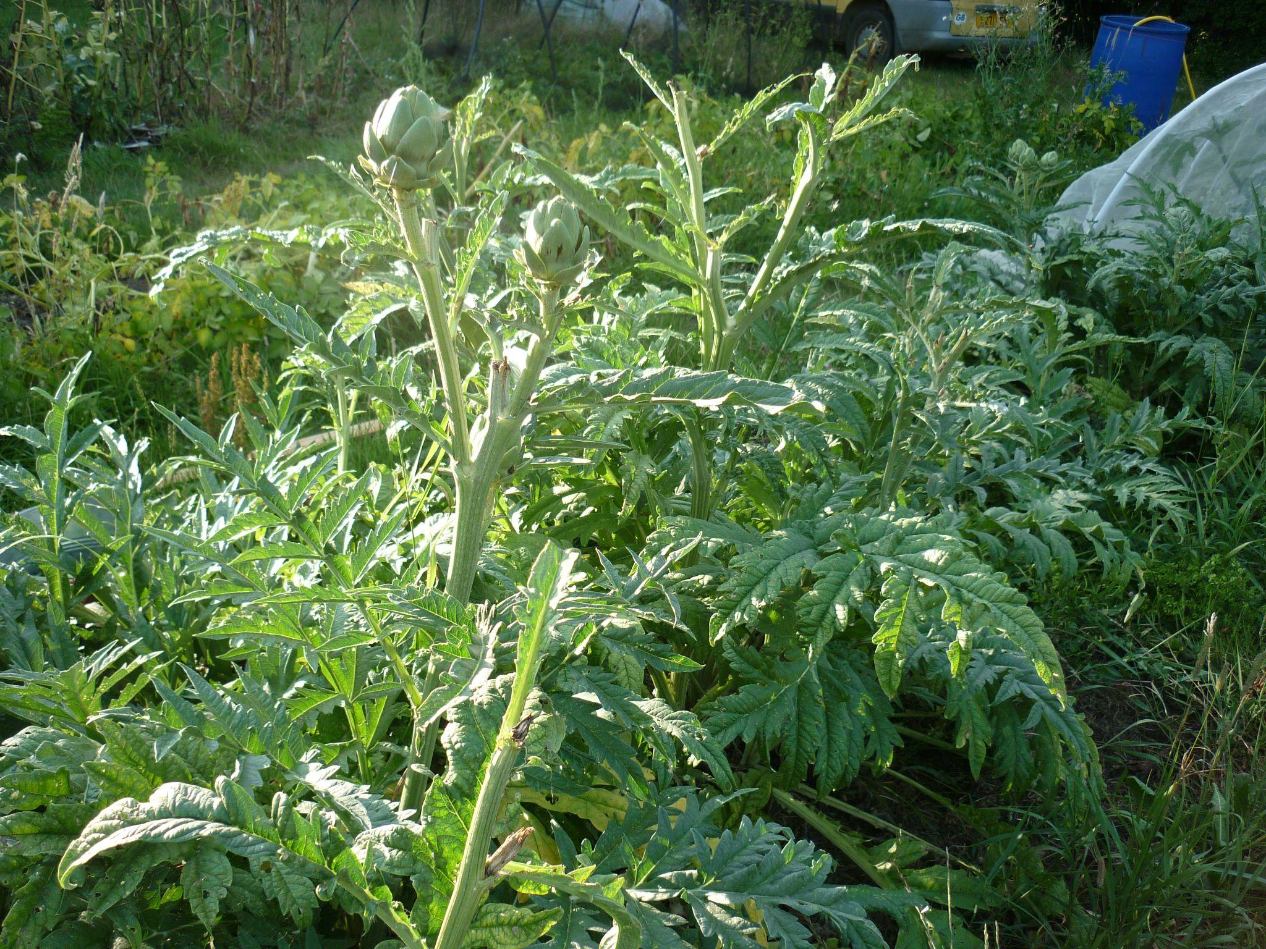
Improve digestive ability
Aromatic digestives black pepper, mustard, ginger, coriander and cumin
Bitters tonic formula:
Three parts artichoke Cynara scolymus
two parts Angelica archangelica
two parts blessed thistle Carbenia benedicta
one part fennel seed Foeniculum vulgare
one part gentian Gentiana lutea
one part bitter orange peel Citrus aurantium fr.
one part ginger Zingiber officinale
one part centaury Centaurium erythraea

Slide 26
Treat the liver
Most people with intolerances will need some liver work, especially those who are dairy intolerant. Establish whether the liver needs calming or stimulant liver herbs, use cholagogues* to improve digestion, use hepatoprotectives….do some detoxing with diet work.
A hot or overactive liver tends to be linked with weight gain, damp, heat, skin rash, hypertension, raised blood lipids, sluggishness, craves fats/proteins. Needs calming/cooling agrimony, burdock, dandelion*, vervain*, yarrow.
A cool, stagnant, underactive liver linked with weight loss, dryness, craving carbs/sweets, dislikes rich, fatty foods, multiple sensitivities. Needs warming/stimulating angelica, Berberis vulgaris*, calendula, mugwort, Rumex crispus*.

Slide 27
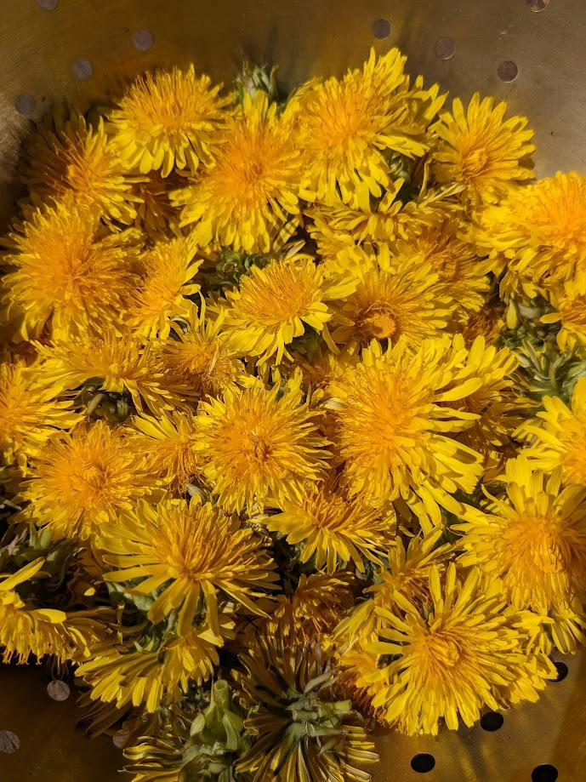
supplements
Vit D – if deficient there is promotion of leaky gut and exaggeration of systemic effects of food intolerance – also anti inflammatory
L glutamine well tolerated gut healer; has been shown to reduce inflammation and heal the intestinal wall..
L-glutamine can be taken as a powder or capsule, starting with a low dose and building up to around 20g daily, or to tolerance. – also found in good amounts in good red meat
Vit C and omega 3's anti inflammatory

Slide 28
probiotics
Probiotics / fermented foods also important part of treatment of leaky gut as they help to heal the gut lining as well as reduce dysbiosis, an important cause of leaky gut
The geni Lactobacillus, Bifidobacterium, Bacillus or Saccharomyces boulardii, most researched probiotics for gut health
probiotics only transient improvement in “healthy” individuals, so the benefits are only present while the probiotic is being taken. There is also evidence to support the use of probiotics in improving immune system response, bowel movement and stool consistency. But there appears to be no persistent changes in microbiome make up. S.Khalesi et al A review of probiotic supplementation in healthy adults: helpful or hype? Eur J Clin Nutr. 2019 Jan;73(1):24-37.
However where dysbiosis is present and there are gastrointestinal symptoms there is evidence for restorative and protective effects of probiotics.N.B.Kristensen et al Alterations in fecal microbiota composition by probiotic supplementation in healthy adults: a systematic review of randomized controlled trials. Genome Med. 2016 May 10;8(1):52
One study showed the use of probiotics reduced zonulin in stools. M.Lamprecht et al Probiotic supplementation affects markers of intestinal barrier, oxidation, and inflammation in trained men; a randomised, double-blinded, placebo-controlled trial. J Int Soc Sports Nutr. 2012 Sep 20;9(1):45.

Slide 29
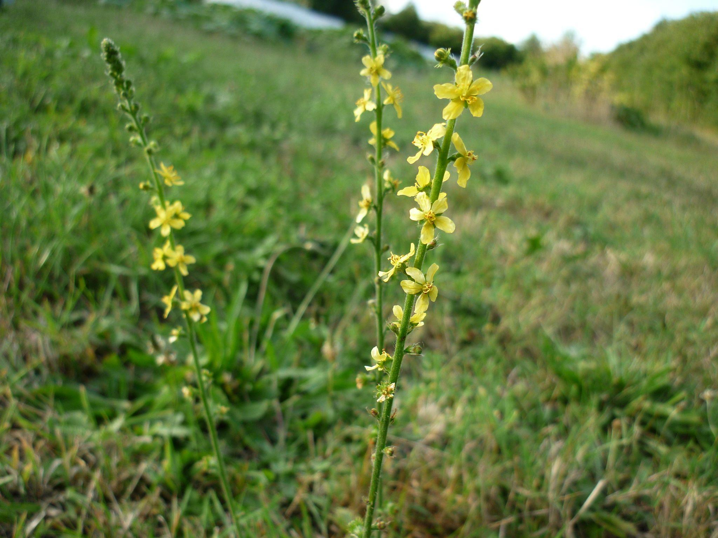
Some useful herbs
gut anti inflammatories – agrimony, chamomile, garlic, angelica, barberry, boswellia, cinnamon, turmeric, wild yam, meadowsweet, fennel, goldenseal, hypericum, lavender, sage, rosemary, milk thistle, pau d’arco, thyme, slippery elm, nettle, ginger, yarrow, mint, calendula, marshmallow, aloe vera, liquorice, plantain
reishi - immune tonic – inhibits histamine, alleviating allergic sensitivities – anti inflammatory – astringent – adaptogenic
scutellaria baicalensis –bitter, inhibits histaminic reactions, cooling, inflammation mediating
nettle and plantain – reduce histamine reactions

Slide 30
